Slide 1
Developing Alternative Diagnostic Pathways
Dysregulation of micro-RNAs in neurodevelopment as a predictive mechanism for diagnosing schizophrenia

Slide 2
What is Schizophrenia
Schizophrenia is a neuropsychiatric disorder characterized by abnormalities of the nervous system
Visual Hallucinations
Verbal Hallucinations
Paranoia

Slide 3
Misdiagnose of Schizophrenia among minorities
Issue
Minorities less likely to be diagnosed with mood disorder
Minorities more likely to be diagnosed with Psychotic disorders
Clinician bias due to stereotyping
Sides Effects Of Medication
Restlessness
Tremors
Muscle Spasms

Slide 4
Questions?
Can we effectively measure mi-RNA expression levels from samples taken from the prefrontal cortex, and can we translate this into a diagnostic tool?

Slide 5
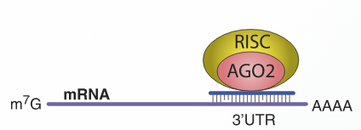
MicroRNA Functions
MiRNA Cleavage
MiRNA Translational Repression

Slide 6
Microarray
Normal Tissue Sample
Abnormal Tissue Sample
Addition of Buffers to Extract mRNA
mRNA
mRNA

Slide 7
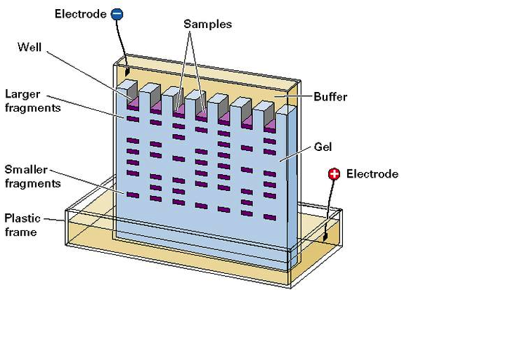
Gel Electrophoresis

Slide 8
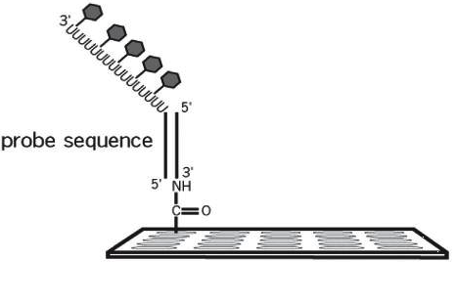
Isolating MicroRNA for a Microarray
Poly(A) Polymerase Labeling
Addition of our dye’s
Pipet into Microarray
Shingara et. al. Method

Slide 9
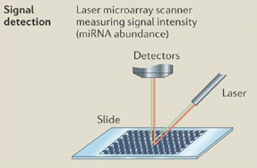
Detection

Slide 10
Can we use MicroRNA expressions levels to diagnose Schizophrenia?
Benefit
Limitations
Quantitative Analysis
(Schizophrenia with False Discovery Rate Factored In)
Verification with QPCR
(Con-Control, SCZ-schizophrenia for miR-132)
Must be less than 0.05 to be significant

Slide 11
References
Ambros, V. (January 01, 2001). microRNAs:Tiny Regulators with Great Potential. Cell,107, 7, 823-826.
Barnes, A. (January 01, 2008). Race and Hospital Diagnoses of Schizophrenia and Mood Disorders. Social Work, 53, 1, 77-83.
Calin, G. A., & Croce, C. M. (January 01, 2006). MicroRNA signatures in human cancers. Nature Reviews. Cancer, 6, 11, 857-66.
Chekanova, J. A., & Belostotsky, D. A. (January 01, 2006). MicroRNAs and messenger RNA turnover. Methods in Molecular Biology (clifton, N.j.), 342, 73-85.
National Institute of Mental Health (U.S.). (2008). Mental health medications. Rockville, Md.: National Institute of Mental Health, U.S. Dept. of Health and Human Services, National Institutes of Health.
Li, F., & Tsien, J. Z. (July 16, 2009). Memory and the NMDA Receptors. New England Journal of Medicine, 361, 3, 302-303.
Miller, B. H., Zeier, Z., Xi, L., Lanz, T. A., Deng, S., Strathmann, J., Willoughby, D., ... Wahlestedt, C. (January 01, 2012). MicroRNA-132 dysregulation in schizophrenia has implications for both neurodevelopment and adult brain function. Proceedings of the National Academy of Sciences of the United States of America, 109, 8, 3125-30.
Mukherjee, S., Shukla, S., Woodle, J., Rosen, A. M., & Olarte, S. (January 01, 1983). Misdiagnosis of schizophrenia in bipolar patients: a multiethnic comparison. The American Journal of Psychiatry, 140, 12, 1571-4.
Oxford University Press. (2007). Concise colour medical dictionary. Oxford: Oxford University Press.
miRVANA miRNA Isolation Kit Ambion RNA by Life Technologies
flashpage reaction cleaup kit Ambion Applied Biosystems
SHINGARA, JACLYN, KEIGER, KERRI, SHELTON, JEFFREY, LAOSINCHAI-WOLF, WALAIRAT, POWERS, PATRICIA, CONRAD, RICHARD, BROWN, DAVID, ... LABOURIER, EMMANUEL. (2005). An optimized isolation and labeling platform for accurate microRNA expression profiling. Copyright 2005 by RNA Society.

