Slide 2
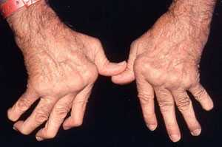
Inflammation Due To RA
http://www.cedars-sinai.edu/Patients/Health-Conditions/Images/354031_Adv_Rheumatoid_Arthritis-2sm.jpg

Slide 3
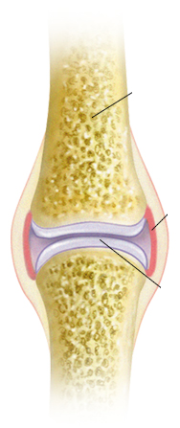
Normal Joint
Bone

Slide 4
Normal Joint
Bone
Synovium

Slide 5
Normal Joint
Bone
Synovium
Cartilage

Slide 6
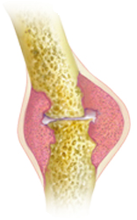
Rheumatoid Arthritis
Synovial Inflammation
Bone Destruction
http://www.riversideonline.com/source/images/image_popup/mcdc7_arthritis_types.jpg

Slide 7
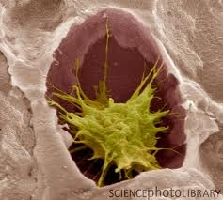
Osteoclasts

Slide 8
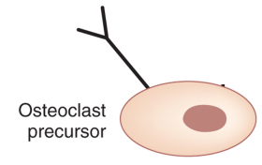

Slide 9


Slide 10


Slide 11
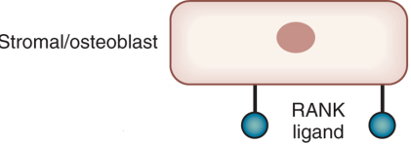

Slide 12


Slide 13


Slide 14
T helper Cells??

Slide 15

Th17 Cells

Slide 16
In Rheumatoid Arthritis,
Do Th17 Cells play a major role in osteoclast differentiation in vivo?

Slide 17
In Rheumatoid Arthritis,
Do Th17 Cells play a major role in osteoclast differentiation in vivo?
Can osteoclast differentiation be induced in vitro by Th17 via RANK/RANKL mechanism?

Slide 18
Kim et al (2012)

Slide 19
Kim et al (2012)
RANKL

Slide 20

Kim et al (2012)
RANKL

Slide 21
Kim et al (2012)
Vitamin D
RANKL

Slide 22
Kim et al (2012)
Vitamin D
RANKL
3 FOLD

Slide 23
Quantitative PCR
After Reaction with RANKL

Slide 24
Quantitative PCR
After Reaction with RANKL
RT-PCR / Sybr Green
TRAP RNA
GAPDH reference gene

Slide 25
Since TRAP protein is only produced in osteoclasts, it can be used to measure differentiation.

Slide 26
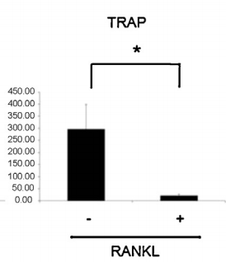
Kim et al

Slide 27
Kim et al

Slide 28
Kim et al

Slide 29
Kim et al

Slide 30
Kim et al
% of GAPDH

Slide 31
Kim et al
% of GAPDH
Reduced Osteoclast Differentiation

Slide 32
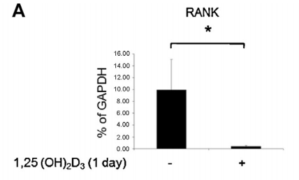
Kim et al
Reduced RANK expression
NO RANKL

Slide 33
Kim et al
Reduced RANK expression
Reduction

Slide 34
Proposed Experiment
T helper Cells

Slide 35
Proposed Experiment
T helper Cells
Vitamin D

Slide 36
Can osteoclast differentiation be induced in vitro by Th17 via RANK/RANKL mechanism?
Th17 in synovium
Capable of inducing differentiation via RANKL/Rank
Kim et al showed that Vitamin D inhibits via RANK

Slide 37
In Rheumatoid Arthritis,
Do Th17 Cells play a major role in osteoclast differentiation in vivo?
Use T cell specific RANKL knockout mice.

