Slide 1
Insulin signaling pathways in Age-related locomotor impairment
Min Im

Slide 2
What is insulin signaling?
Insulin
A hormone produced by pancreatic cells to regulate amount of glucose in the blood
Triggers the uptake of glucose, fatty acids, and amino acids into liver and stores them in forms of glycogen, lipids, and proteins
Insulin Signaling
A communication between the insulin receptors and receptor substrate proteins to function properly
Insulin signaling pathway
Coordinated pathway to regulate glucose, lipid, and proteins

Slide 3
What is ARLI?
Age-related Locomotor Impairment
A decrease in muscle mass and body movement due to aging
Why do we care about ARLI?
Patients with ARLI are at greater risk for falling, skeletal fractures, obesity, diabetes, hypertension, and more!
How can we help?
Unfortunately, little is known about the genes and genetic pathways that influence ARLI
So we need an experiment!

Slide 4
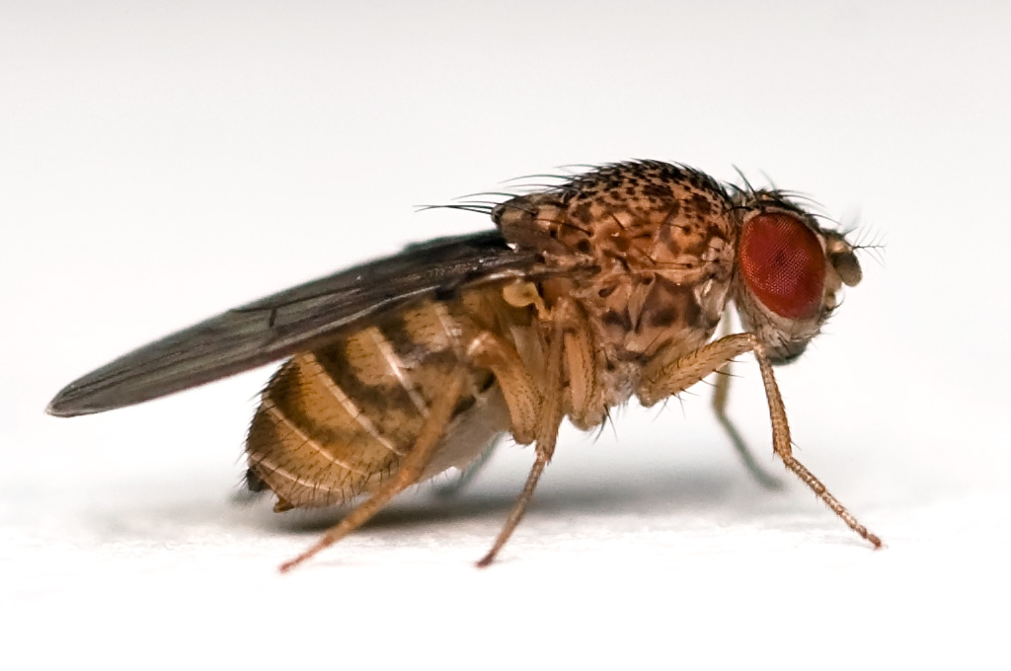
However…
Performing an aging-related experiment in human will take VERY VERY LONG time
Instead…
we use fruit flies, Drosophila!
Credit: Wikipedia

Slide 5
Why Drosophila?
Commonly used Model Organism
Small and easy to grow in labs
Complete genome is sequenced and published in 2000!
Recognizable similarities between human and Drosophila
Short lifespan
Average of 30 days
possible to evolve many generations of fruit flies in a short time period
Perfect model organism for aging-related experiment!!!

Slide 6
In Previous studies
Jones et al (2009) claimed that insulin signaling is a key regulator of ARLI in Drosophila
They identified insulin signaling genes that delayed ARLI
PDK1, Dp110, Akt
All three genes are components of phosphoinositide 3-kinase (PI3K) insulin signaling pathway
How about other insulin pathways??
Information about other pathways are not found yet

Slide 7
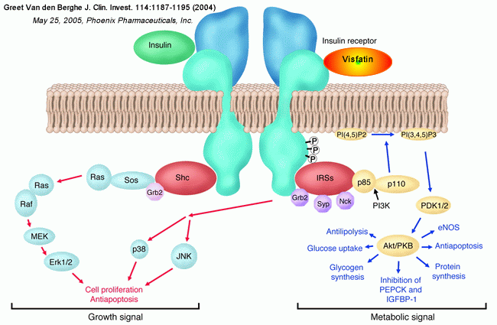
Therefore…
A new experiment is proposed on Ras-mitogen-activated kinase (MAPK) pathway to see if insulin signaling genes of MAPK pathway also influences ARLI
Genes: upstream of MAPK: RAS, RAF, MEK
downstream of MAPK: ERK1

Slide 8
Experiment methods
P-element insertion
Real-time PCR
Negative Geotaxis

Slide 9
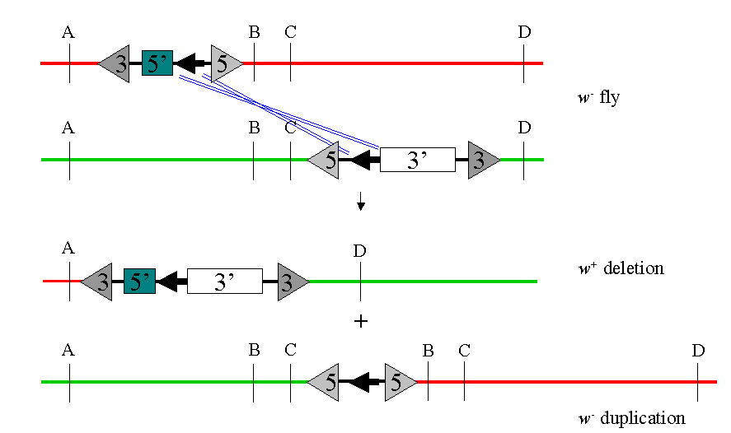
Methods: P-element insertion
P-element is a DNA sequence that could copy its own sequence and insert it into a different position
A method used to insert P-element into an insertion site in order to create genetically modified flies

Slide 10
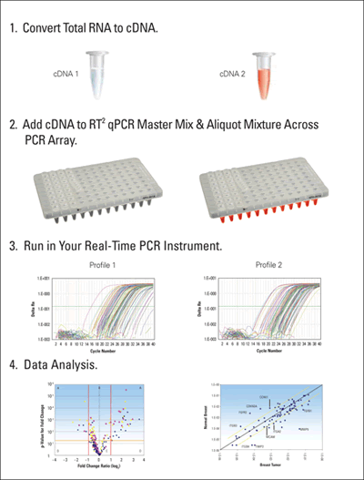
Where to insert?
Using real-time Polymerase Chain Reaction (PCR)

Slide 11
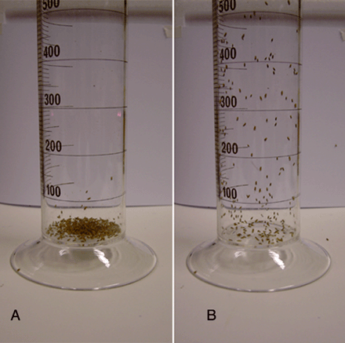
Methods: Negative Geotaxis
Geotaxis means walking against the gravity (or Climbing)
Distance climbed at 4sec will be measured in weekly interval
If any of the flies didn’t move within 4 seconds, they were scored 0

Slide 12
Experiment
1. Identify MAPK insulin genes: RAS, RAF, MEK, ERK1
2. Identify insertion sites using real-time PCR
3. P-element insertion into an insertion site to create mutant groups
4. Calculate Negative Geotaxis to collect results
5. Analyze if any of the mutant genes performed different from control group
Possible outcomes
MAPK pathway insulin genes delay or accelerate ARLI
Or Not affective at all

Slide 13
How is that experiment going to help?
If the experiment becomes successful…
we can use insulin pathways as regulators of ARLI
Also, we can search for human gene homologues in flies from online database called Homophila!
If we could find human gene homologues, developing new treatments that relieve the effects of aging is essential!

Slide 14
References
Arking, R., 1998. The Biology of Aging: Observations and Principles, second ed.Sinauer Associates, Sunderland, MA
Taniguchi, Cullen M., Brice Emanuelli, and Ronald Kahn. "Critical Nodes In Signalling Pathways: Insights Into Insulin Action." Nature Reviews Molecular Cell Biology 7.2 (2006): 85-96. Academic Search Complete. Web. 2 Dec. 2013.
Melanie A. Jones, et al. "A forward genetic screen in Drosophila implicates insulin signaling in age-related locomotor impairment."Experimental Gerontology. 44. (2009): 542-540. Web. 16 Oct. 2013. <http://www.ncbi.nlm.nih.gov/pubmed/19481596>.
Grotewiel, Mike, and Melanie A. Jones. "Drosophila as a Model for Age-Related Impairment in Locomotor and other Behaviors." Experimental Gerontology. 45(5). (2011): 320-325. Web. 16 Oct. 2013. <http://www.ncbi.nlm.nih.gov/pmc/articles/PMC3021004/>.
Rodenizer, Devin, Mike Grotewiel, et al. "Genetic and environmental factors impact age-related impairment of negative geotaxis in Drosophila by altering age-dependent climbing speed." Experimental Gerontology. 43(8).739-748 (2008): n. page. Web. 16 Oct. 2013. <http://www.ncbi.nlm.nih.gov/pmc/articles/PMC2591094/>.
Massimo Zeviani, et al. "Mutations In TTC19 Cause Mitochondrial Complex III Deficiency And Neurological Impairment In Humans And Flies." Nature Genetics 43.3 (2011): 259-263. Academic Search Complete. Web. 18 Oct. 2013.
Andrew G. Davies, Ryan I. Friedberg, Hersh Gupta, Chung-Lung Chan, Keith L. Shelton, Jill C. Bettinger, Different genes influence toluene- and ethanol-induced locomotor impairment in C. elegans, Drug and Alcohol Dependence, Volume 122, Issues 1–2, 1 April 2012, Pages 47-54, ISSN 0376-8716, http://dx.doi.org/10.1016/j.drugalcdep.2011.08.030. (http://www.sciencedirect.com/science/article/pii/S0376871611003905)
R. St. Laurent, L.M. O’Brien, S.T. Ahmad, Sodium butyrate improves locomotor impairment and early mortality in a rotenone-induced Drosophila model of Parkinson’s disease, Neuroscience, Volume 246, 29 August 2013, Pages 382-390, ISSN 0306-4522, http://dx.doi.org/10.1016/j.neuroscience.2013.04.037. (http://www.sciencedirect.com/science/article/pii/S030645221300362X) Ian Martin, Melanie A. Jones, Mike Grotewiel, Manipulation of Sod1 expression ubiquitously, but not in the nervous system or muscle, impacts age-related parameters in Drosophila, FEBS Letters, Volume 583, Issue 13, 7 July 2009, Pages 2308-2314, ISSN 0014-5793, http://dx.doi.org/10.1016/j.febslet.2009.06.023. (http://www.sciencedirect.com/science/article/pii/S0014579309004712)

