Slide 1
Determination of host-associated bacterial communities
In the rhizospheres of maize, acorn squash, and pinto beans

Slide 2
Host-associated microbial communities
Eukaryotes play host to large and complex microbial communities
In humans, for instance, 90% of the cells are accounted for by the host-associated microbes
These communities have a symbiotic relationship with the host; the health of the host is dependent upon the capabilities of the microbes and the populations in some ways reflect the health of the host.

Slide 3
Potential
It is theorized that gaining an understanding of host-associated communities can open up new avenues of treatment
E.G. Introduction of healthy bacteria rather than drugs with side affects or chemicals with harmful environmental collateral damage
The communities are represented by an enormous amount of extremely dynamic data so applications are still currently theoretical
Studies of these communities required for this potential to ever be realized

Slide 4
Rhizosphere
In plants, much of the host-associated microbial communities lies in the soil immediately surrounding the roots
This area is known as the rhizosphere.

Slide 5
Rhizosphere symbiosis
The microbes in the rhizosphere help the host plant to process nutrients, for instance.
Well known example are bacteria that help plants such as legumes form nodules on the roots, into which the bacteria move and then use the resources provided by the host plant to fix nitrogen, which then helps the plant to thrive.

Slide 6
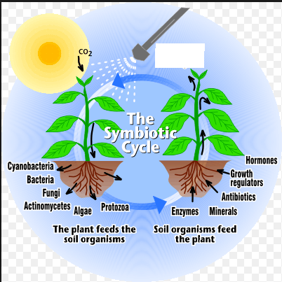
Rhizosphere symbiosis

Slide 7
16S rRNA
Ribosomal RNA has been used extensively for organism identification
It is well conserved within a species and sometimes across species
It is also abundant in cells providing much in the way of material
Several rRNA regions have been used, but 16S is the most commonly used region and there are large libraries with 16S data for a wide variety of organisms

Slide 8
PCR
Polymerase chain reaction is a well used method for gene amplification
A pair of restriction enzyme are used, specifically to book-end a stretch of RNA or single stranded DNA
This fragment is called a probe
Probes can be amplified by insertion into phage DNA and grown in culturable bacteria such as e. coli
The probes are tagged for identification and hybridized on the DNA or RNA

Slide 9
“Unculturable” bacteria
The vast majority of bacteria cannot be grown under known laboratory conditions
Some put that fraction at 99%
Theories are that stress conditions or inadequate environmental conditions prevent bacteria from multiplying
Host-associated bacteria are a perfect example because they generally need a proper host to thrive

Slide 10
In situ
One approach to analyzing “unculturable” bacteria is to study the bacteria “in situ” – in a natural (or nearly natural environment) – rather than in vivo
This way the required resources are available to the bacteria
Down side is that the environmental conditions provide a great deal of background noise
For instance, how to tell the host-associated bacteria in soil from other bacteria in the neighborhood?

Slide 11
FISH
Fluorescent In Situ Hybridization – FISH – uses this approach.
Final hybridization step occurs in situ
Fluorescent markers are used to tag the probes for identification and quantification by fluorescence microscopy and/or flow cytometry.

Slide 12
FISH (visual)

Slide 13
Three sisters
Pre-Columbian American agricultural technique
Plant three crops – one ground cover (squash), one legume (bean), and one tall grain the beans can climb (maize)
Complementary nutrient cycle – legumes fix the nitrogen, for example

Slide 14
Experimental bed
To provide samples and a giant, dirty petri dish for hybridization, an experimental garden bed will be prepared
Samples will be taken and analyzed before planting to quantify bacteria without hosts present
Sub beds will be planted – maize, squash, bean, maize/bean, maize/squash, bean/squash, maize/bean/squash
Each bed will be analyzed for bacterial content several times during the season

Slide 15
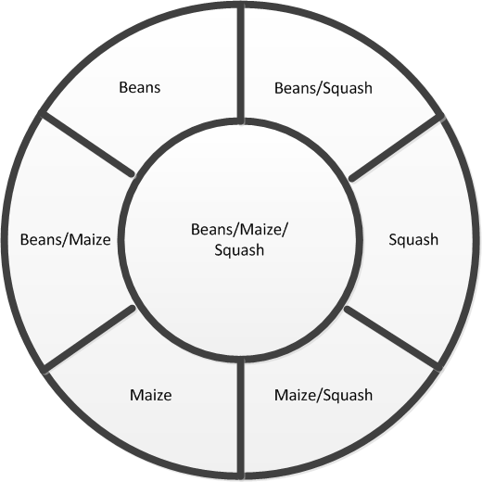
Experimental Bed

Slide 16
16S rRNA relative qPCR FISH
Analysis will be 16S relative quantitative PCR fluorescent in situ hybridization
Multiple primers will be used for probe templating
One probe will be for “universal” bacteria; the others will select for specific bacterial taxa
Universal results will be used to normalize for relative bacterial quantification

Slide 17
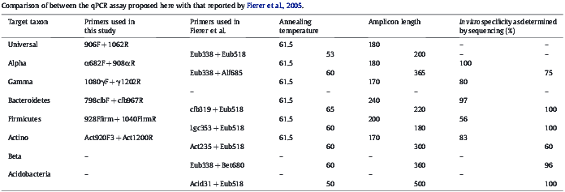
Probe primers
Primers tested by Fierer and Gregoris experiments

Slide 18
Relative quantification
Within each biom, relative quantities will be calculated
Relative quantities will be compared with the “unhosted” samples and with the relative quantities from other beds to see how the hosts affect total and relative bacterial populations

Slide 19
Further studies
The idea behind the experimental bed is to add to the study over years
Other identical beds could be made in different locations with different soil and environmental conditions but same hosts
Bacteria could be introduced to see impact
Environmental factors such as nutrient levels, temperature, moisture, pH, salinity could be factored in
Charcoal (in the vein of tera preta) could be introduced

Slide 20
Bacterial meta-genomic sequencing
High-throughput total genome sequencing should be incorporated
Meta-genomic data could be used to partially identify bacteria closer to the species
qPCR data may assist in partial sequencing of the bacteria
Meta-genomic data itself may wind up being more important than the speciation

