Slide 1
Components of Neutrophil Extracellular Traps and their Origin
Vince Yokois

Slide 2
The Question
Do all the factors that NETs compose of derive from neutrophils, or are they obtained from another source?
Strategies to take advantage of mutant cell function will be used
Be able to distinguish from local and non-local cells
Observe results to view what is actually there
Test results to know what is present

Slide 3
Purpose
Better understanding of what neutrophils do or do not produce
Prove whether or not neutrophils are assisted by some other cell
Limitations on what they can kill
Further testing

Slide 4
Introduction
The immune system is the body’s first line of defense
Uses a different number of methods to ward off antigens
Inflammation
White Blood Cells
Antibodies

Slide 5
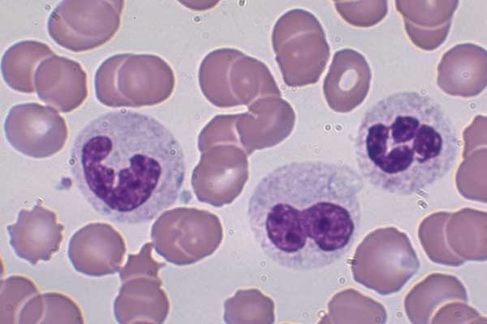
Neutrophils
Most common WBC in the body and arguably the most important
Kills bacteria by phagocytosis
Is not restricted to the blood
First line of defense
Figure 1 http://mmserver.cjp.com/images/image/4303024.jpg

Slide 6
NETs
In 2004, Brinkman et el. described a secondary structure for neutrophils
Extracellular Traps
DNA web structure
Consists of antimicrobial factors
Can trap bacteria and kill outside of the cell

Slide 7
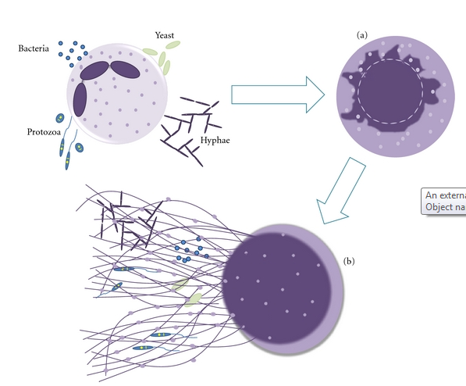
How Do They Work?
Neutrophils have been extensively researched since their discovery
Play roles in Cancer, Autoimmune Diseases, and Inflammation
Entire Pathway of how NETs produced is unknown
NADPH oxidase
ROS Factors
Figure 2 from Guimares et al. (2012).

Slide 8
Summary of Experiment
Mice with an inflammatory reaction will be injected with labeled neutrophils, so that NET structures can be observed in the tissue and tested for local protein activity.

Slide 9
Methods
Mice Strains
SJL, healthy mice, known to produce NETs
JAX, mutated NADPH oxidase, no NETs
Inflammatory Reaction
Induced by a lipopolysaccharide
Sub-dermally implanted
Isolating Neutrophils
Blood samples from labeled mice will be taken
Neutrophils isolated by centrifuge

Slide 10
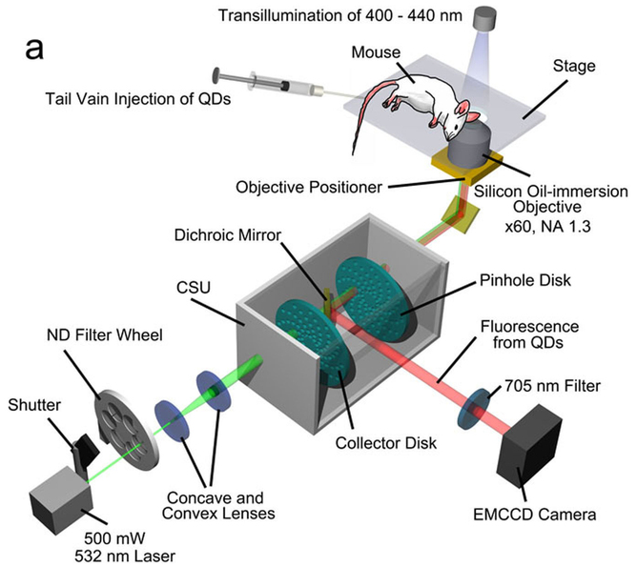
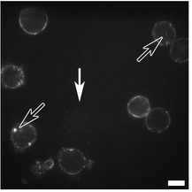
Methods
Radioactively Label DNA, Protein
Injected with radioactive methionine
Neutrophils will be injected with BrdU
Track Neutrophils
Quantum Dots implanted into cell membrane
by antigen-QD conjugate
Non-invasive
Figure 4
High intensity laser used to detect QD’s
Kikushima et al. (2013)
Figure 3
Neutrophils with QD’s method described by Kikushima et al. (2013)

Slide 11
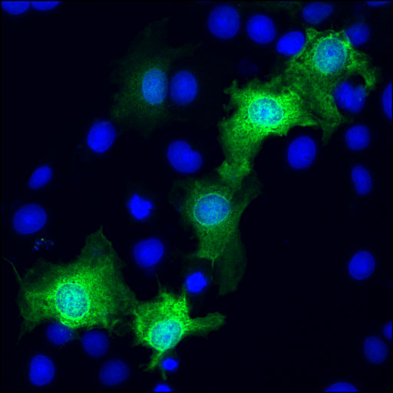
Methods – His-tags
Incorporates an amino acid motif into the protein
Antibodies can bind to these and attach fluorophores
Attached at the N or C termini
Figure 5 http://www.cellsignal.com/products/images/2365_ific_Jp.jpg

Slide 12
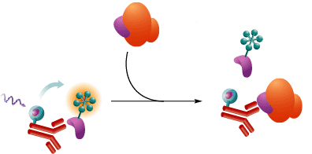
Methods – His-tags
His-tag +Primer
Primer
DNA Protein Sequence
PCR
His-tag + DNA encoding Protein

Slide 13
Methods
Measure Enzymatic Activity
Get ELISA kits for each protein to be tested
Ratio of Fluorometric Assay : Radiometric Assay
Immunofluorescence Staining
Stain tissue samples with antibodies (His-tags)
Items to be stained; MPO, PX3, Lactoferrin, Cathelicidin, Neutrophil DNA
Figure 6 taken from results of Urban et al. (2009)

Slide 14
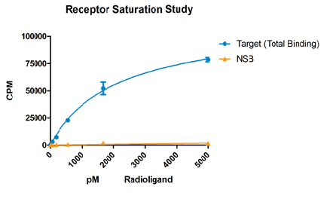
Results
Enzymatic Activity
Displayed as a ratio of REA : FEA
If the ratio’s are equal then all proteins in NETs originate from neutrophils
If FEA is more than REA there are proteins in the NETs that did not come from the neutrophil

Slide 15
References
1. http://mmserver.cjp.com/images/image/4303024.jpg
2. Guimarães-Costa A.B., Nascimento M.T., Wardini A.B., Pinto-da-Silva L.H., Saraiva E.M. ETosis: A Microbicidal Mechanism beyond Cell Death. J. Parasitol. Res. 2012;2012:929743. http://www.ncbi.nlm.nih.gov/pubmed/22536481/?ncbi_mmode=std
3. Kikushima, Kenji, Kita, Sayaka, Higuchi, Hideo. A non-invasive imaging for the in vivo tracking of high-speed vesicle transport in mouse neutrophils. Sci. Rep. 2013/05/31/online. http://www.nature.com/srep/2013/130530/srep01913/full/srep01913.html#ref7
4. ^
5. http://www.cellsignal.com/products/images/2365_ific_Jp.jpg
6. Urban CF, Ermert D, Schmid M, Abu-Abed U, Goosmann C, et al. Neutrophil extracellular traps contain calprotectin, a cytosolic protein complex involved in host defense against Candida albicans.PLoS Pathog. 2009;5:e1000639 http://www.ncbi.nlm.nih.gov/pubmed/19876394/

