Slide 1
Difference in Gene Regulation by Smad and CLIC proteins in Drosophila
Michael Vuong

Slide 2
Alcohol Study
National Institute on Alcohol Abuse and Alcoholism
About 1 in 4 people who drink heavily may have alcohol dependence or abuse problems
Large majority of heavy drinkers are in late teens, early 20s age

Slide 3
What can we do?
Genetic versus Environmental factors that lead to development of alcohol abuse and disorders
Lots of research regarding environmental factors
Little is known genetic pathways
Human experimentation very difficult

Slide 4
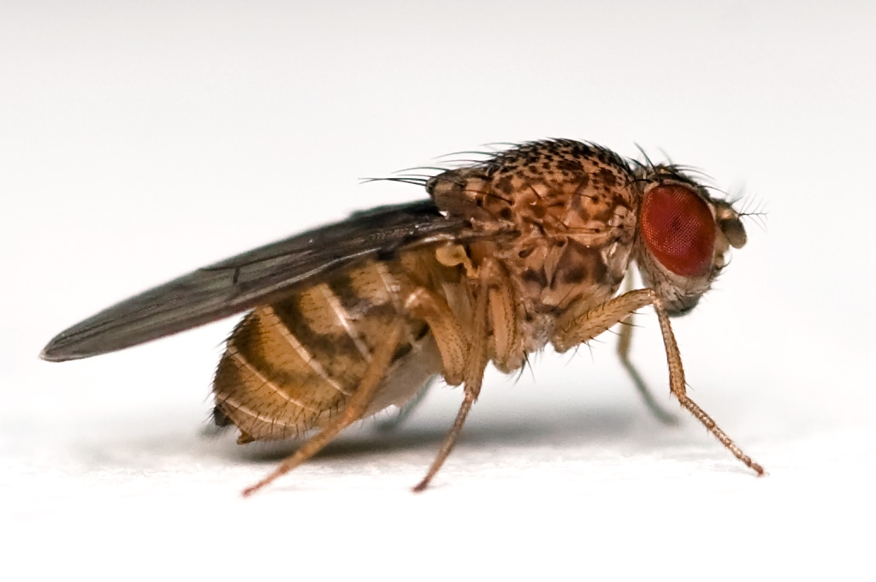
Drosophila melanogaster
Model Organism
Very useful for genetic experiments
Easy to grow and care for
Distinguishable morphology and gender
High fecundity
Recognizable similarities between human and fly genes

Slide 5
Discovery of CLIC
Bhandaria et al (2012) discovered Chloride Intracellular Channel proteins played a major role in development of alcohol sensitivity in flies
However, mechanism underlying the relationship is still unknown

Slide 6
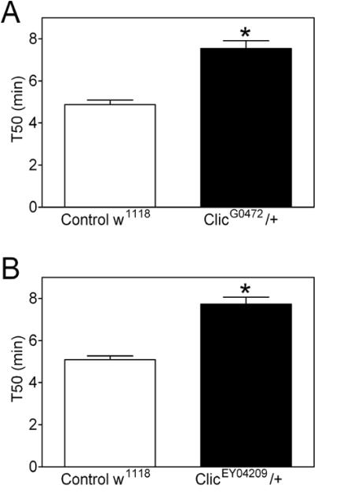
Ethanol Rapid Iterative Negative Geotaxis (eRING)
-Startle-induced vertical climbing
-Bhandari et al(2012)

Slide 7
Transforming Growth Factor-Beta Signaling Pathway
Shukla et al (2009) discovered the presence of CLIC in TGF-β signaling pathway
Interacts with Smad proteins to activate transcription
Notes:
Smad is critical protein in TGF beta

Slide 8
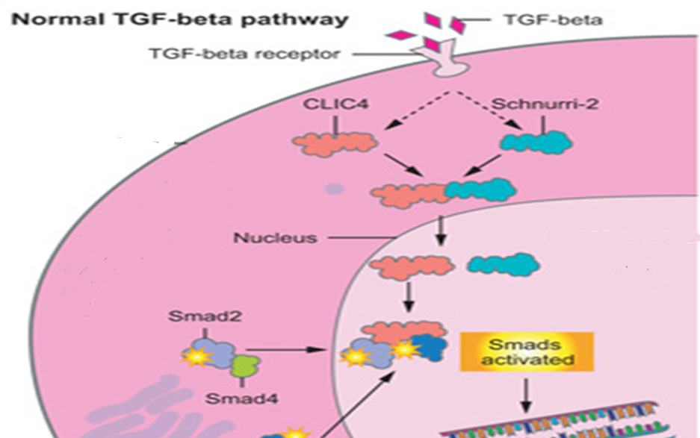

Slide 9
Aim of Experiment
Do Smad proteins and CLIC proteins perform similar gene regulation in Drosophila?
Notes:
Affymatrix has DNA chip

Slide 10
CLIC and Smad Mutants
RNAi used to produce transgenic flies
CLIC silenced
Smad silenced

Slide 11
DNA Microarray
Allows for experimentation on thousands of genes, such as entire drosophila genome
Precise location of each gene recorded
Arranged in rows on a glass microscope slide-sized chip

Slide 12
CLIC Mutant
Sample
Control Sample
Control Sample
Smad Mutant Sample

Slide 13
CLIC Mutant
Sample
Control Sample
Control Sample
Smad Mutant Sample
Samples centrifuged and mRNA extracted through buffers

Slide 14
CLIC Mutant
Sample
Control Sample
Control Sample
Smad Mutant Sample
Samples centrifuged and mRNA extracted through buffers
mRNA
mRNA
mRNA
mRNA

Slide 15
CLIC Mutant
Sample
Control Sample
Control Sample
Smad Mutant Sample
Samples centrifuged and mRNA extracted through buffers
mRNA
mRNA
mRNA
mRNA
mRNA converted into cDNA through reverse transcriptase enzyme
Fluorescent nucleotides attached to cDNA

Slide 16
CLIC Mutant
Sample
Control Sample
Control Sample
Smad Mutant Sample
Samples centrifuged and mRNA extracted through buffers
mRNA
mRNA
mRNA
mRNA
mRNA converted into cDNA through reverse transcriptase enzyme
Fluorescent nucleotides attached to cDNA
cDNA
cDNA
cDNA
cDNA

Slide 17
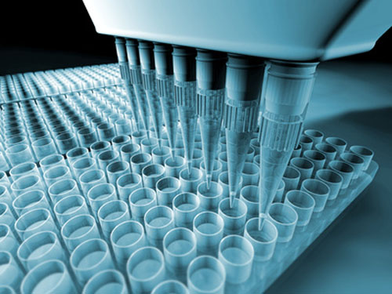

Slide 18
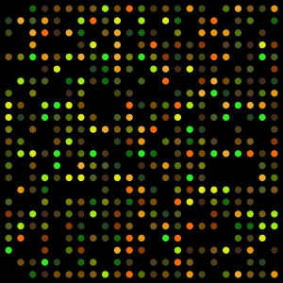
cDNA hybridized to specific spots on slide containing its complementary sequence
Spots are excited by laser
Scanned at certain wavelengths to detect red and green dyes

Slide 19
Expression Ratios
Ratio of spot intensity, or expression level, in comparison to normal gene expression
Genes that do not differ will have expression ratio of 1
Up regulated genes [1, ∞]
Down-regulated genes [0,1]

Slide 20
Up-regulate vs Down Regulate
CLIC Regulated Genes
versus
Smad Regulated Genes
CLIC Regulated Genes
versus
Smad Regulated Genes

Slide 21
Expected Results
If overlap, CLIC and Smad (and possibly TGF-β) have conserved roles in gene expression in Drosophila
Further behavioral tests can be done to confirm results
Most up/down regulated genes can be selected for further investigation

Slide 22
Why does this matter?
The information from this experiment could be used for several future applications
Designing therapeutic treatment for alcohol disorder
Run diagnostics tests for patients predisposed to alcohol disorder
Drugs to prevent alcohol disorders at genetic level

Slide 23
References
Bhandari, P., J. S. Hill, S. P. Farris, B. Costin, I. Martin, C. L. Chan, J. T. Alaimo, J. C. Bettinger, A. G. Davies, M. F. Miles and M. Grotewiel (2012). "Chloride intracellular channels modulate acute ethanol behaviors in Drosophila, Caenorhabditis elegans and mice." Genes Brain Behav 11(4): 387-97
Kong EC, Allouche L, Chapot PA, Vranizan K, Moore MS, Heberlein U, Wolf FW. " Ethanol-regulated genes that contribute to ethanol sensitivity and rapid tolerance in Drosophila." Alcohol Clin Exp Res. 2010 Feb;34(2):302-16
Shukla, A., M. Malik, C. Cataisson, Y. Ho, T. Friesen, K. S. Suh and S. H. Yuspa (2009). "TGF-beta signalling is regulated by Schnurri-2-dependent nuclear translocation of CLIC4 and consequent stabilization of phospho-Smad2 and 3." Nat Cell Biol 11(6): 777-84.Berryman, M. A. and J. R. Goldenring (2003). "CLIC4 is enriched at cell-cell junctions and colocalizes with AKAP350 at the centrosome and midbody of cultured mammalian cells." Cell Motil Cytoskeleton 56(3): 159-72.
http://learn.genetics.utah.edu/content/labs/microarray/
Morozova TV, Ayroles JF, Jordan KW, Duncan LH, Carbone MA, Lyman RF, Stone EA, Govindaraju. " Alcohol sensitivity in Drosophila: translational potential of systems genetics." Genetics. 2009 Oct;183(2):733-45, 1SI-12SI.
Shanks, R. A., M. C. Larocca, M. Berryman, J. C. Edwards, T. Urushidani, J. Navarre and J. R. Goldenring (2002). "AKAP350 at the Golgi apparatus. II. Association of AKAP350 with a novel chloride intracellular channel (CLIC) family member." J Biol Chem 277(43): 40973-80.

