Slide 1
Regulation of ORMDL3 Gene Expression through the ERK/CREB Pathway
Annie Vo

Slide 2
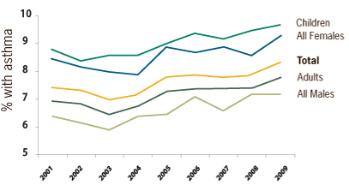
Asthma
Chronic inflammatory disease
Airway inflammation
Airway hyperreactivity
Increasing every year, particularly in developed countries
5-16% of the world population afflicted
Figure 1 Asthma in the U.S from 2001 to 2011. A slight increase in asthma prevalence in various groups evidence in recent years. Children are consistently the biggest population in the total count.

Slide 3
Vitamin A Supplementation
Lowered amounts found in asthmatic patients
Vitamin A involved with enhancing maintenance of airways
Instead, increased inflammatory factors
Mechanism not fully understood
Zhuang et al. (2013) proposed a mechanism by which vitamin A increased the onset of asthma.

Slide 4
How does vitamin A affect asthma?
Vitamin A

Slide 5
How does vitamin A affect asthma?
Vitamin A
ATRA
(all-trans retinoic acid)

Slide 6
How does vitamin A affect asthma?
Vitamin A
ATRA
(all-trans retinoic acid)
PKA
PKA*
(protein kinase A)
(activated)

Slide 7
How does vitamin A affect asthma?
Vitamin A
ATRA
(all-trans retinoic acid)
PKA
PKA*
(protein kinase A)
(activated)
CREB
P-CREB
(inactive transcription factor)
(phosphorylated)

Slide 8
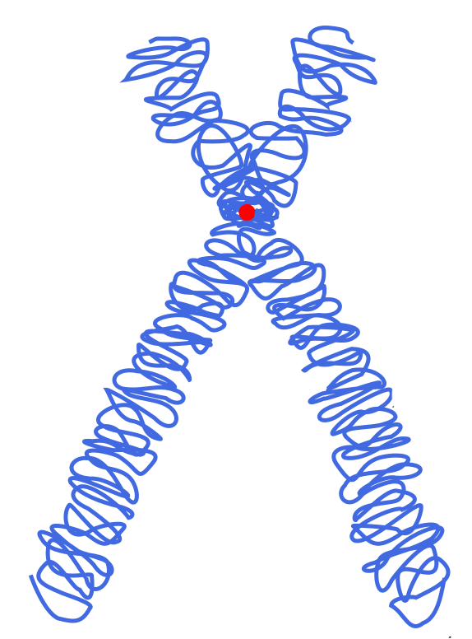
How does vitamin A affect asthma?
Vitamin A
ATRA
(all-trans retinoic acid)
PKA
PKA*
(protein kinase A)
(activated)
ORMDL3 gene
CREB
P-CREB
(inactive transcription factor)
(phosphorylated)

Slide 9
How does vitamin A affect asthma?
Vitamin A
ATRA
(all-trans retinoic acid)
ORMDL3
PKA
PKA*
(protein kinase A)
(activated)
ORMDL3 gene
CREB
P-CREB
(inactive transcription factor)
(phosphorylated)

Slide 10
What is ORMDL3?
Orosomucoid 1-like 3
Associated with onset of childhood asthma
Expressed in bronchial epithelial cells
Encodes an ER trans-membrane protein
Binds to the Ca²⁺ pump on the sacro-endoplasmic reticulum
Imbalance of Ca²⁺ increase the unfolded protein response in ER
Causes upregulation of inflammatory factors

Slide 11
Testing the model: Does ATRA increase P-CREB?
Vitamin A
ATRA
(all-trans retinoic acid)
ORMDL3
PKA
PKA*
(protein kinase A)
(activated)
ORMDL3 gene
CREB
P-CREB
(inactive transcription factor)
(phosphorylated)

Slide 12
Testing the model: Does ATRA increase P-CREB?
Vitamin A
ATRA
(all-trans retinoic acid)
ORMDL3
PKA
PKA*
(protein kinase A)
(activated)
ORMDL3 gene
CREB
P-CREB
(inactive transcription factor)
(phosphorylated)

Slide 13
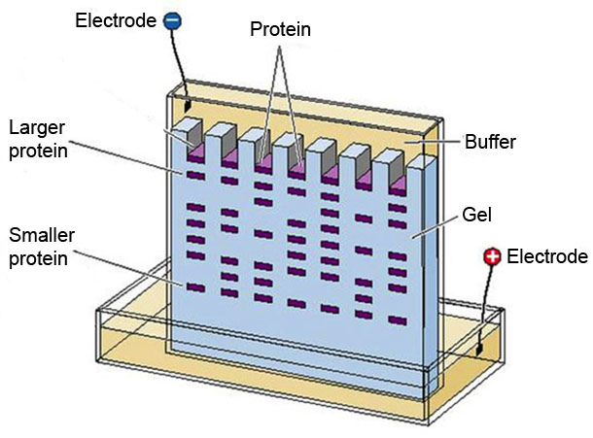
Gel Electrophoresis

Slide 14
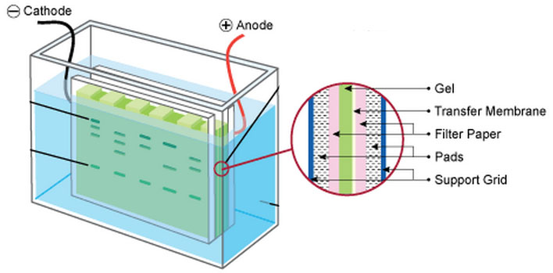
Electroblotting

Slide 15
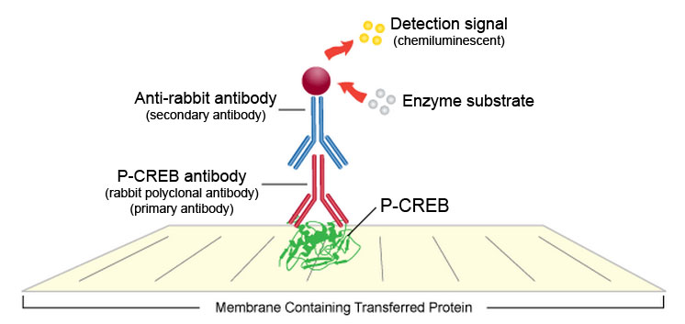
Western Blot

Slide 16
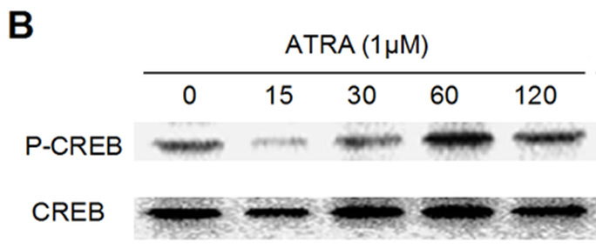
Does ATRA increase P-CREB?
(Zhuang et al. 2013)

Slide 17
Does ATRA increase ORMDL3 expression?
Vitamin A
ATRA
(all-trans retinoic acid)
ORMDL3
PKA
PKA*
(protein kinase A)
(activated)
ORMDL3 gene
CREB
P-CREB
(inactive transcription factor)
(phosphorylated)

Slide 18
Does ATRA increase ORMDL3 expression?
Vitamin A
ATRA
(all-trans retinoic acid)
ORMDL3
PKA
PKA*
(protein kinase A)
(activated)
ORMDL3 gene
CREB
P-CREB
(inactive transcription factor)
(phosphorylated)

Slide 19
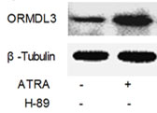
Does ATRA increase ORMDL3 expression?
(Zhuang et al. 2013)
Is ATRA-induced ORMDL3 expression dependent on PKA?

Slide 20
Is expression dependent on PKA?
Vitamin A
ATRA
(all-trans retinoic acid)
ORMDL3
H-89
PKA
PKA*
(protein kinase A)
(activated)
ORMDL3 gene
CREB
P-CREB
(inactive transcription factor)
(phosphorylated)

Slide 21
Is expression dependent on PKA?
(Zhuang et al. 2013)

Slide 22
Are there other kinases that lead to ORMDL3 expression?
Vitamin A
ATRA
(all-trans retinoic acid)
ORMDL3
ERK1/2
ERK1/2*
(Extracellular signal-regulated kinase-1 and 2 )
(activated)
ORMDL3 gene
CREB
P-CREB
(inactive transcription factor)
(phosphorylated)

Slide 23
Are there other kinases that lead to ORMDL3 expression?
Vitamin A
ATRA
(all-trans retinoic acid)
ORMDL3
ERK1/2
ERK1/2*
(Extracellular signal-regulated kinase-1 and 2 )
(activated)
ORMDL3 gene
CREB
P-CREB
(inactive transcription factor)
(phosphorylated)

Slide 24
Are there other kinases that lead to ORMDL3 expression?
Vitamin A
ATRA
(all-trans retinoic acid)
ORMDL3
?
ERK1/2
ERK1/2*
(Extracellular signal-regulated kinase-1 and 2 )
(activated)
?
ORMDL3 gene
CREB
P-CREB
(inactive transcription factor)
(phosphorylated)

Slide 25
Methods
Vitamin A
ATRA
(all-trans retinoic acid)
ORMDL3
H-89
PKA
ERK1/2
ERK1/2*
(Extracellular signal-regulated kinase-1 and 2 )
(activated)
ORMDL3 gene
CREB
P-CREB
(inactive transcription factor)
(phosphorylated)

Slide 26
Methods
Vitamin A
ATRA
(all-trans retinoic acid)
ORMDL3
H-89
?
PKA
ERK1/2
ERK1/2*
(Extracellular signal-regulated kinase-1 and 2 )
(activated)
?
ORMDL3 gene
CREB
P-CREB
(inactive transcription factor)
(phosphorylated)

Slide 27
Methods
Vitamin A
ATRA
(all-trans retinoic acid)
ORMDL3
H-89
?
PKA
ERK1/2
ERK1/2*
(Extracellular signal-regulated kinase-1 and 2 )
(activated)
?
ORMDL3 gene
CREB
P-CREB
(inactive transcription factor)
(phosphorylated)

Slide 28
Methods
Controlling kinases
Inhibition of ERK1/2 using U0126
Inhibition of PKA using H-89
Expression of ORMDL3
Western Blot
Near-infrared (NIR) secondary antibody
Measurement of luminescence to determine protein concentration

Slide 29
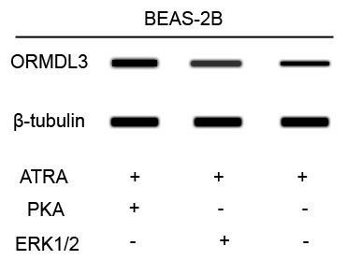
Expected Results
ORMDL3 will be when either PKA or ERK1/2 is present.
A kinase must be present for ORMDL3 to be expressed.

Slide 30
Expected Results
ORMDL3 will be when either PKA or ERK1/2 is present.
A kinase must be present for ORMDL3 to be expressed.

Slide 31
Future Uses
Application:
Regulation of vitamin A intake through diet during childhood years to prevent asthma.
Future Questions:
Synergistic response when both are present?
Why is the amount of protein produced different when varying kinases?

Slide 32
References
Allen, S., Britton, J. R., & Leonardi-Bee, J. a. (2009). Association between antioxidant vitamins and asthma outcome measures: systematic review and meta-analysis. Thorax, 64(7), 610–9.
Dijk, F. N., de Jongste, J. C., Postma, D. S., & Koppelman, G. H. (2013). Genetics of onset of asthma. Current opinion in allergy and clinical immunology, 13(2), 193–202.
GeneLoc. "ORMDL3 Gene in genomic location." GeneCard. Accessed December 5, 2013. http://www.genecards.org/cgi-bin/carddisp.pl?gene=ORMDL3.
Ha, S. G., Ge, X. N., Bahaie, N. S., Kang, B. N., Rao, A., Rao, S. P., & Sriramarao, P. (2013). ORMDL3 promotes eosinophil trafficking and activation via regulation of integrins and CD48. Nature communications, 4, 2479.
Kang, M.-J., Yu, H.-S., Seo, J.-H., Kim, H.-Y., Jung, Y.-H., Kim, Y.-J., … Hong, S.-J. (2012). GSDMB/ORMDL3 variants contribute to asthma susceptibility and eosinophil-mediated bronchial hyperresponsiveness. Human immunology, 73(9), 954–9.
Leinco. “Detection in Western Blots." Leinco. Accessed December 5, 2013. http://www.leinco.com/general_wb.
Leinco. "Western Blot Setup." Leinco. Accessed December 5, 2013. http://www.leinco.com/general_wb.
Martinez, F. D., & Vercelli, D. (2013). Asthma. Lancet, 382(9901), 1360–72.
National Institute of Allergy and Infectious Diseases, National Institutes of Health. Asthma in the U.S. (http://www.niaid.nih.gov/topics/asthma/understanding/Pages/usAsthma.aspx; Accessed December 2013)
The Vitamin Magazine. "Great Sources of Vitamin A." The Vitamin Mag. Accessed December 5, 2013. http://www.thevitaminmag.com/vitamin-a-foods-foods-high-in-vitamin-a/.
Zhuang, L.-L., Huang, B.-X., Feng, J., Zhu, L.-H., Jin, R., Qiu, L.-Z., & Zhou, G.-P. (2013). All-Trans Retinoic Acid Modulates ORMDL3 Expression via Transcriptional Regulation. PloS one, 8(10), e77304.
Zhuang, L.-L., Jin, R., Zhu, L.-H., Xu, H.-G., Li, Y., Gao, S., … Zhou, G.-P. (2013). Promoter characterization and role of cAMP/PKA/CREB in the basal transcription of the mouse ORMDL3 gene. PloS one, 8(4), e60630.

