Slide 1
The Effects of Increased Net Reactive Oxygen Species on Mitophagy
Donald Ta

Slide 2
Dementia
Lin et al (2006) says that oxidative stress has been thought to contribute to aging, which is a major risk factor for dementia (But how?)

Slide 3
What does ethanol do to a cell?
Increases oxidative stress
How?
Increases cellular metabolism
Lowers levels of antioxidants

Slide 4
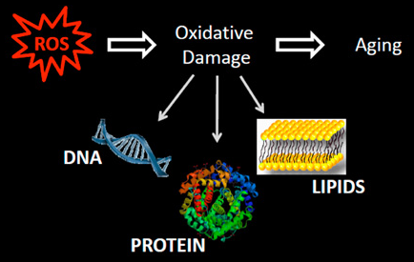
Increased oxidative stress

Slide 5
Reddy et al (2013) found that alcohol-induced oxidative stress can alter the brain mitochondrial make-up and this is due to accumulation of dysfunctional mitochondria

Slide 6
Mitophagy
Selective breakdown of dysfunctional or damaged mitochondria
Mitochondria gets tagged for degradation→ degraded in lysosome/vacuole
Prevents accumulation of the damaged or dysfunctional mitochondria

Slide 7
Mitophagy is not perfect
Environmental factors (Such as abundance of ethanol exposure)
Process can get overwhelmed
Imbalance of Reactive Oxygen Species in Cell (ROS)
Not an even ratio of ROS being produced and removed → accumulation of damaged or dysfunctional mitochondria
Net ROS
Main contributor to aging

Slide 8
What do I want to know?
I hypothesize that increased ethanol exposure will elicit lower levels of GFP processing
Om45-green fluorescence protein is a mitochondrial outer membrane protein complex that binds to the mitochondria
Mitophagy initiated→mitochondria degraded in lysosome/vacuole→Om45 degraded, but GFP in-tact

Slide 9
Does ethanol elicit Om45-GFP processing in yeast cells?
Produce yeast cells expressing Om45-GFP
Expose yeast cell groups to different levels of ethanol
Measure the levels of GFP still in-tact
How will I measure these levels?

Slide 10
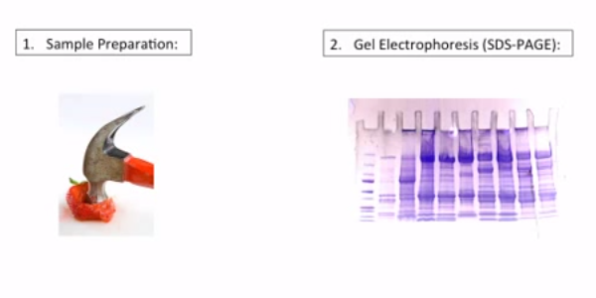
Western Blot
Used to detect for specific proteins in given sample

Slide 11
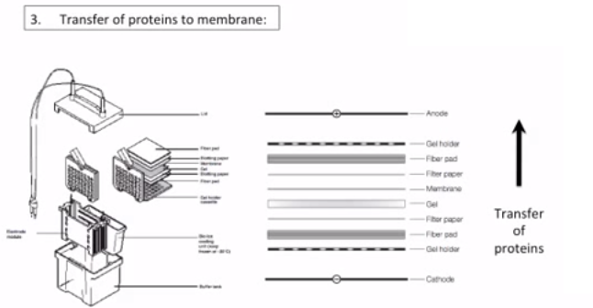

Slide 12
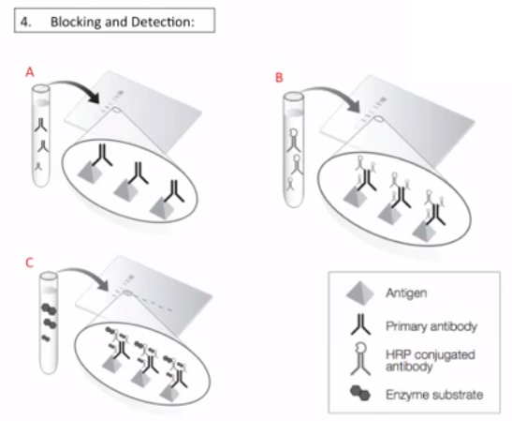

Slide 13
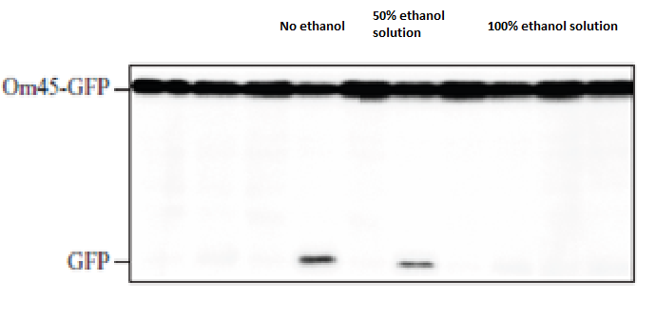

Slide 14
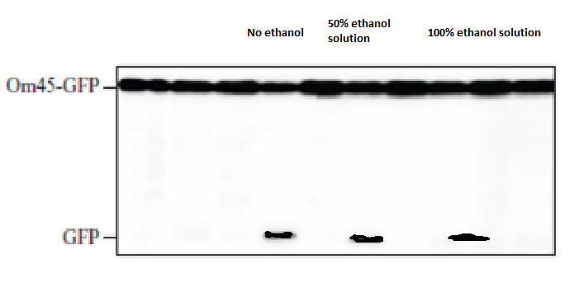

Slide 15
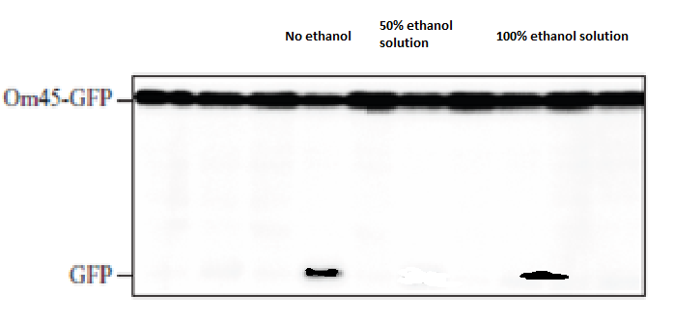

Slide 16
Problems?
Mechanism of mitophagy is still poorly understood
Ethanol exposure can produce factors other than increased ROS
Critical points of ethanol varies by organism

Slide 17
Overall Picture
Ethanol increases oxidative stress in cell can overwhelm mitophagy mechanism
Decrease in levels of mitophagy in a cell which can cause an accumulation of dysfunctional/damaged mitochondria
I will measure this by determining if ethanol elicits GFP processing in yeast cells

Slide 18
Why should you care?
These accumulations of dysfunctional/damaged mitochondria have been liked to aging and neurodegenerative diseases such as dementia
1 in 7 people develop dementia when they reach 70 years old according to the National Institute of Health in 2007
If my hypothesis is correct, that ethanol will NOT elicit GFP processing
Alcohol and dementia
Science Community

