Slide 1
Developing Alternative Diagnostic Pathways
Dysregulation of micro-RNAs in neurodevelopment as a predictive mechanism for diagnosing schizophrenia

Slide 2
What is Schizophrenia
Schizophrenia is a neuropsychiatric disorder
Visual and Verbal Hallucinations
Aggressiveness
Social Isolation
Paranoia

Slide 3
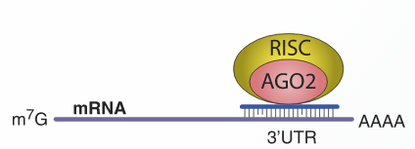
MicroRNA Functions
MicroRNA Cleavage
MicroRNA Translational Repression
RNAi wikipedia page
RNAi wikipedia page
Notes:
Remember to state the location it cleaves at versus the location it represses at
MICRO RNA MICRO RNA MICRO RNA

Slide 4
Developing a Question
Dizocilpine (MK-801) is a NMDA (N-methyl-D-aspartate) Receptor antagonist
MicroRNA-132 is downregulated in the presence of Dizocilpine
Miller et al found that MicroRNA-132 is downregulated in individuals with Schizophrenia
MicroRNA-132 and MicroRNA-212 are co-transcribed NMDA Receptor Regulators
Miller et al did not find that MicroRNA-212 to have abnormal expression levels
Are microRNA-212 expression levels downregulated in the presence of Dizocilpine?
Notes:
Image of NMDA receptor and what it does (Die-zo-sill-pine)
MiR-132 and MiR-212 are CREB activated microRNA where as cAMP transcription factor CREB responds to Neurological signals
Dizocilpine (MK-801) is a NMDA Receptor antagonist which blocks the receptors ion channel. Causes user to present symptoms similar to schizophrenia.
MiR-132 is down regulated in the presence of Dizocilpine in a similar fashion as it is in Humans with schizophrenia
MiR-132 and MiR-212 are co-transcribed NMDA Receptor Regulators and the NMDA receptor takes part in synaptic pruning during neurodevelopment

Slide 5
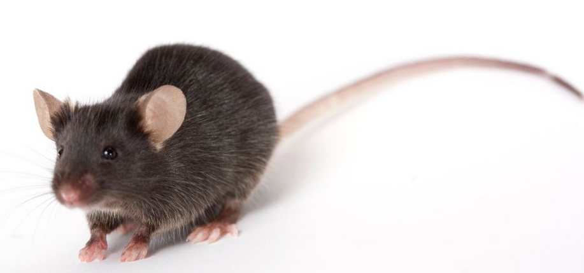
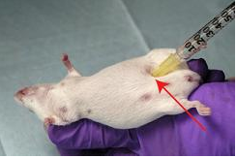
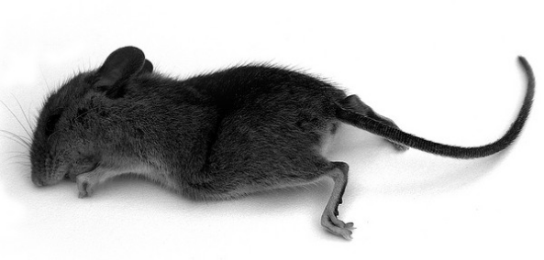
Model Organism
Small
Cost Effective
Similar Genome
Black-6 Mouse
Inject Dizocilpine Intraperitoneally
Sacrifice Mice and Harvest Tissue Sample
The Jackson Laboratory
US National Institutes of Health

Slide 6
Microarray
Normal (Saline) Tissue Sample
Dizocilpine Tissue Sample
Addition of Buffers to Extract RNA
RNA
RNA
Notes:
Label healthy green and unhealthy red

Slide 7
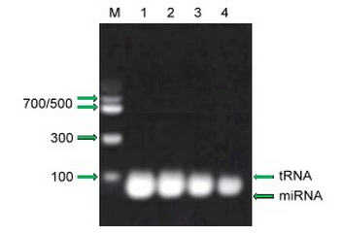
Gel Electrophoresis
Excise gel slice
Add binding solution to gel slice
Add Silca Suspension
Re-suspend and wash with buffers
Transfer Purified miRNA
Thermo Scientific Bio based on Vogelstein and Gillespie
Notes:
Cut down here. Not necessary

Slide 8
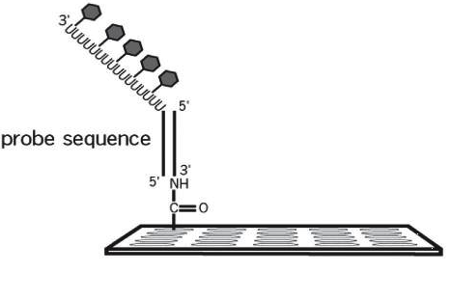
Isolating MicroRNA for a Microarray
Poly(A) Polymerase Labeling
Addition of our dye’s
Pipet into Microarray
Shingara et al Method

Slide 9
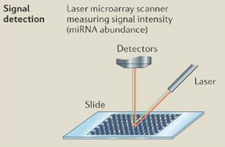
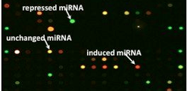
Detection
Shingara et al Method

Slide 10
Expectations and Limitations
Limitations with Microarrays
Expected miR-212 Results (mimic miR-132 results)
Variances in measurements can have a negative effect on Quantitative Analysis Results
Necessitate Verification with QPCR
Use of model organism versus human subjects
Miller et al

Slide 11
The Issue
Misdiagnosis among minorities
Why should things change?
Issue
Minorities less likely to be diagnosed with mood disorder
Minorities more likely to be diagnosed with Psychotic disorders
Clinician bias due to stereotyping
More “Buy In” with scientific or medical data
Sides Effects Of Medication
Restlessness
Tremors
Muscle Spasms

Slide 12
References
Ambros, V. (January 01, 2001). microRNAs:Tiny Regulators with Great Potential. Cell,107, 7, 823-826.
Barnes, A. (January 01, 2008). Race and Hospital Diagnoses of Schizophrenia and Mood Disorders. Social Work, 53, 1, 77-83.
Calin, G. A., & Croce, C. M. (January 01, 2006). MicroRNA signatures in human cancers. Nature Reviews. Cancer, 6, 11, 857-66.
Chekanova, J. A., & Belostotsky, D. A. (January 01, 2006). MicroRNAs and messenger RNA turnover. Methods in Molecular Biology (clifton, N.j.), 342, 73-85.
National Institute of Mental Health (U.S.). (2008). Mental health medications. Rockville, Md.: National Institute of Mental Health, U.S. Dept. of Health and Human Services, National Institutes of Health.
Li, F., & Tsien, J. Z. (July 16, 2009). Memory and the NMDA Receptors. New England Journal of Medicine, 361, 3, 302-303.
Miller, B. H., Zeier, Z., Xi, L., Lanz, T. A., Deng, S., Strathmann, J., Willoughby, D., ... Wahlestedt, C. (January 01, 2012). MicroRNA-132 dysregulation in schizophrenia has implications for both neurodevelopment and adult brain function. Proceedings of the National Academy of Sciences of the United States of America, 109, 8, 3125-30.
Mukherjee, S., Shukla, S., Woodle, J., Rosen, A. M., & Olarte, S. (January 01, 1983). Misdiagnosis of schizophrenia in bipolar patients: a multiethnic comparison. The American Journal of Psychiatry, 140, 12, 1571-4.
Oxford University Press. (2007). Concise colour medical dictionary. Oxford: Oxford University Press.
miRVANA miRNA Isolation Kit Ambion RNA by Life Technologies
flashpage reaction cleaup kit Ambion Applied Biosystems
SHINGARA, JACLYN, KEIGER, KERRI, SHELTON, JEFFREY, LAOSINCHAI-WOLF, WALAIRAT, POWERS, PATRICIA, CONRAD, RICHARD, BROWN, DAVID, ... LABOURIER, EMMANUEL. (2005). An optimized isolation and labeling platform for accurate microRNA expression profiling. Copyright 2005 by RNA Society.

