Slide 2
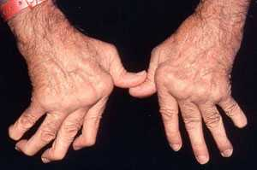
Inflammation Due To RA
http://www.cedars-sinai.edu/Patients/Health-Conditions/Images/354031_Adv_Rheumatoid_Arthritis-2sm.jpg
Notes:
RA is characterized by pain and swelling f the joints
Most commonly, hands, feet and knees
Autoimmune response, body’s attempt at protecting itself from a perceived threat

Slide 3
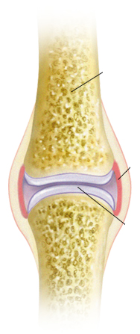
Rheumatoid Arthritis
Attack on flexible joints
Bone
Synovium
Cartilage

Slide 4
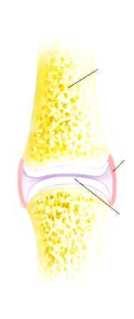
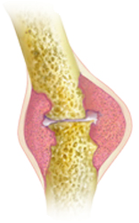
Rheumatoid Arthritis
Attack on flexible joints
Bone
Synovial Inflammation
Synovium
Bone Destruction
Cartilage

Slide 5
Rheumatoid Arthritis
What causes it?
Synovial Inflammation
Bone Destruction
http://www.riversideonline.com/source/images/image_popup/mcdc7_arthritis_types.jpg

Slide 6
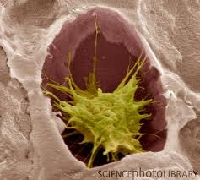
Osteoclast cells
Bone destroyers
Notes:
: The label "Osteoclasts" on a white background detracts from the image. Better to make the background of the text box invisible. To do that, click the box, then Format (top of screen), then Text Fill, then No Fill. I've provided an example of what I mean (changing the color of the text to make it more visible).

Slide 7


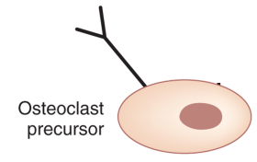
Osteoclast Formation
Surface Bound Protein
Notes:
Again, I found the animation of a figure wiping slowly right to left irritating. I would eliminate the animation. It's appearance is enough to draw our attention to RANK. Also, I presume that RANK is supposed to be attached to the osteclast precursor cell. You can do this in one of several ways:
Make the background of the picture transparent (using Photoshop or a Photoshop-like program, e.g. GIMP)
Draw a black line connecting the picture of RANK with the picture of the cell
Make a duplicate of the RANK picture, one for the upper part (including the word RANK) and one for the line below RANK. Crop the second picture so that it can touch the cell without erasing any of the cell.

Slide 8
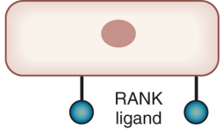
Osteoclast Formation
osteoblast
Notes:
: "Stromal" is a nicety we don't need., "Osteoblast" is enough.

Slide 9


Osteoclast Formation
osteoblast

Slide 10
Th17 Cells
Type of T-helper Cells
Major role in inflammation during RA
Produce signaling molecules
Present in the synovial fluid in RA patients
Notes:
molecules that attract other immune cells

Slide 11
1,25 dimethydroxyvitamin D3 (1,25 (OH)₂ D3)
Active Vitamin D
Known inhibitor of bone resorption
Vitamin D deficiency is common in RA patients
Can inhibit osteoclast differentiation

Slide 12
Can osteoclast differentiation be induced in vitro by Th17 via cell to cell contact?
Notes:
: Similarly, the question "Can osteoclast differentiation..." should appear on the same slide as Th17 cells, where the basis for the question is apparent. This question should replace the previous question to avoid cluttering the slide. This is a key point in your presentation. Take the time to pause and say the central question with emphasis, reminding us why it is connected to understanding rheumatoid arthritis.

Slide 13
The Experiment
[Osteoclast precursors + Th17 Cells]
with and without [1,25 (OH)₂ D3]
Measure osteoclast differentiation
qPCR on mRNA of TRAP protein from osteoclasts
Notes:
Briefly explain what differentiation is

Slide 14
Since TRAP protein is produced only in osteoclasts, it can be used to measure osteoclast differentiation.
Notes:
: "Since TRAP protein is only produced..." (you mean "produced only..."). This should be boiled down to something like "marker of differentiation" and put on the previous slide.

Slide 15
Quantitative real-time PCR
Amplify DNA
RNA primers target gene
Fluorescence molecules “tag” DNA
Detection
Change in detection can be plotted and analyzed

Slide 16
DNA preparation
RNA transcriptase
mRNA
cDNA

Slide 17
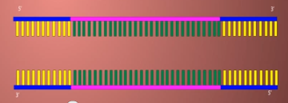
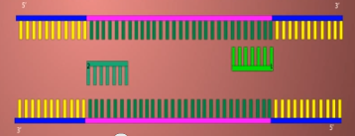
Priming
DNA is heated, separating into single strands.
RNA primers add to adjacent sequence on the 3’ end of target gene.

Slide 18
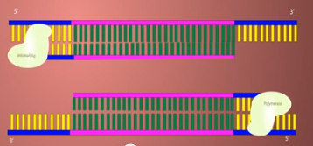
Extension
DNA Polymerase extends new strand starting at the primers towards 5’ end.

Slide 19
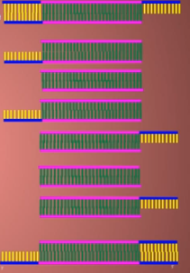
Amplification
Process is repeated until target gene is significantly detected.

Slide 20
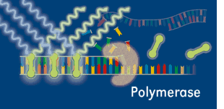
Detection
Sybr Green only attaches to double stranded DNA molecules.
the tagged sequence will be detected.
Notes:
If target gene is present and successfully amplified through PCR,

Slide 21
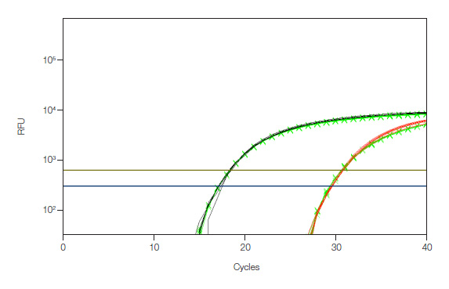
Analysis
Example
GAPDH is used a reference gene
Used in cell respiration
Consistently expressed.
cDNA detected
GAPDH
Target gene
Notes:
The number of cycles relative to specific amount of detection is the CT values
2(ΔCt_control - ΔCt_treatment) = fold change

Slide 22
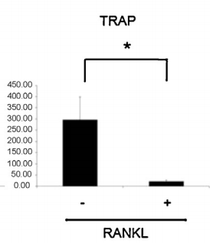
Samples containing only osteoclast precursors
Relative TRAP mRNA levels
Modified from Kim et al
Notes:
Slide 26-33
: I got totally lost in your rapid tour through these slides. I understand them now, given time and a relaxed mind, but these won't be available to your audience. Suggestions:
Keep on the screen the icons from the previous slides to remind us how the system works.
Forget about RANK expression. Explaining one experiment is more than enough.
Either show a hypothetical qRTPCR graph, comparing GAPDH expression to TRAP expression (best) or drop any mention of GAPDH. Without a graph or similar, no one will understand what %GAPDH could possibly mean.

Slide 23
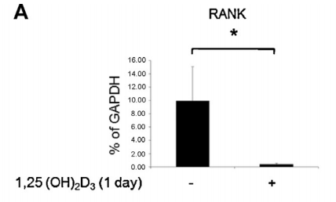
Reduced RANK expression
Relative TRAP mRNA levels
Modified from Kim et al
Notes:
Discussion

Slide 24
In Rheumatoid Arthritis,
Do Th17 Cells play a major role in osteoclast differentiation in vivo?
Use T cell specific RANKL knockout mice.
Collagen Induced Mouse Model

Slide 26
Notes:
Don't bother showing the references. No one can possibly read them. You can leave it in the presentation for those who are examining the slides at their leisure.

