Slide 1
Inferring the Route of Odontotaenius disjunctus gut Microbiome Colonization
Michael Kiflezghi

Slide 2
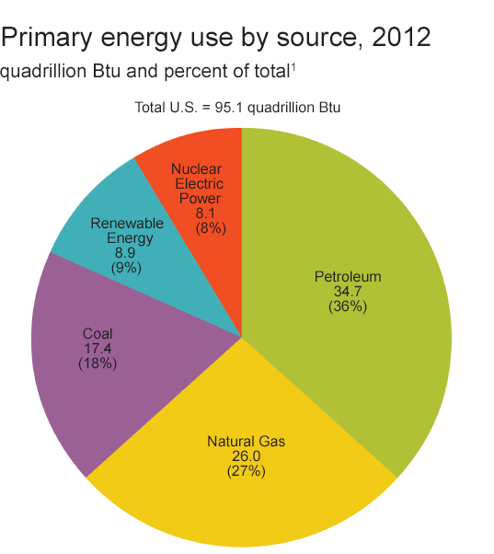
Introduction
World stores of fossil fuel energy sources are running out
Fossil Fuels are major fuel source
Renewable fuels like bioethanol are favorable
Image credit: Energy Information Administration¹

Slide 3
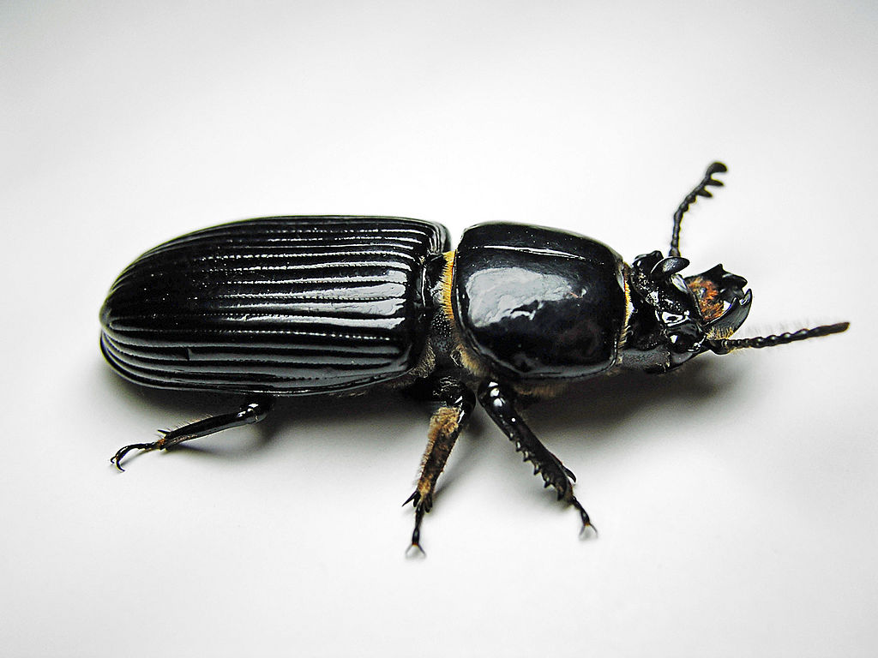
Biological Analogs
Odontotaenius disjunctus subsists on woody biomass
Cellulose digestion attributed to microbes in gut
Biological analog for biomass to biofuel conversion
Image Credit: Wikipedia²

Slide 4
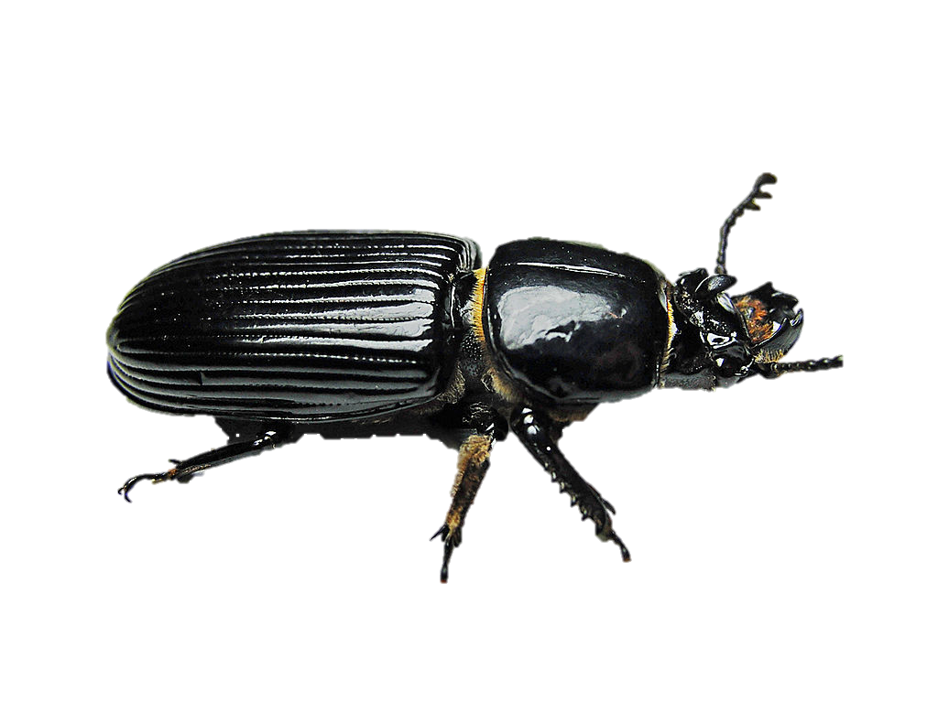
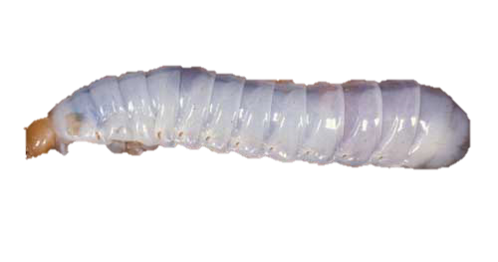
The Question
How do these beetles acquire their microbiome?
More specifically: is it the case that adult O. disjunctus transfer microbes to larvae via excrement?
?

Slide 5
Methods: Overview
Use Green Fluorescent Protein
Track potential colonization of larvae gut
Perform Phylochip microarray assay
Illustrate possible relationship between composition of adult gut microbiome and larvae microbiome

Slide 6
Methods: Culturable Bacteria!
Margulis et al 1998 and Gross 2010 found that B. cereus is culturable from O. disjunctus gut.
Significance:
Assured that bacteria may flourish in gut
Facultative anaerobe
Transformation protocol developed previously (Belliveau & Trevors 1989, and Schurter & Geiser)

Slide 7
Methods: Plasmid Selection
lacP’ (modified lac promoter)
eGFP (enhanced Green Fluorescent Protein)
Amp (beta-lactamase)
Image Credit: addgene.com³

Slide 8
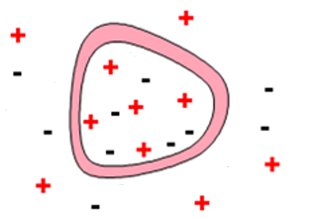
Methods: Generation of fluorescent bacteria
Transformation via Electroporation
Culture transformed bacteria

Slide 9
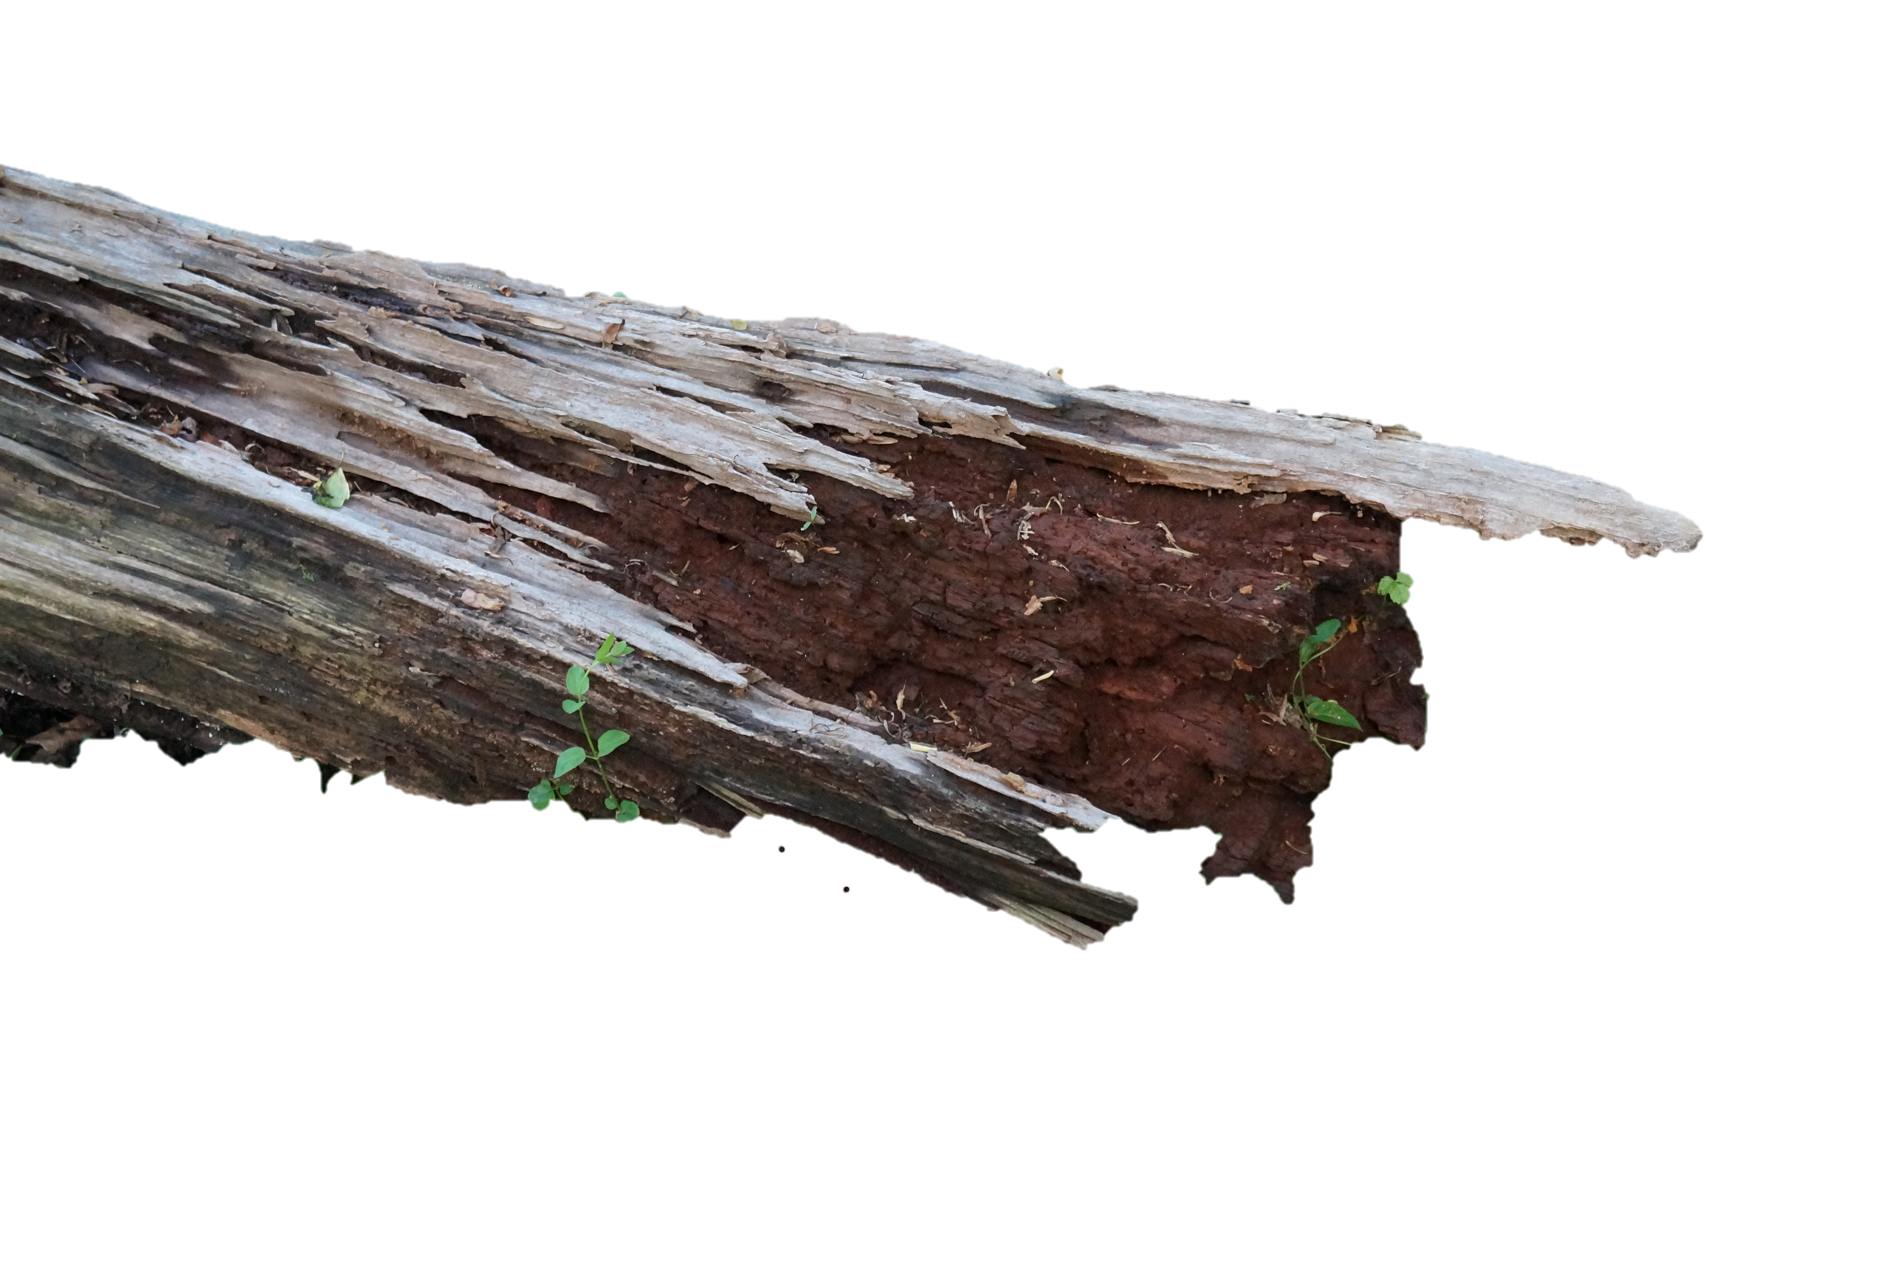
Methods: Exposure
Group 1: expose adults to GFP bacteria
Group 2: GFP bacteria in larvae environment

Slide 10
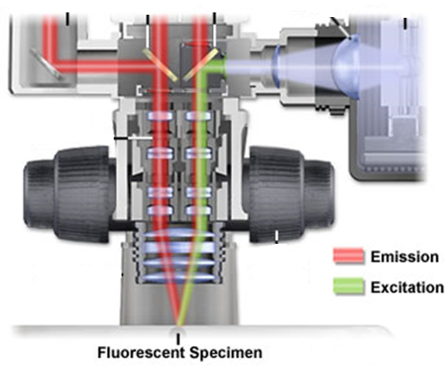
Methods: Visualization
Fluorescent Stereo Microscopy
Image credit: Nikkon³
Notes:
At all steps that require confirmation of the presence of the GFP bacteria, samples will be sacrificed for fluorescence.

Slide 11
Again
How are microbes acquired by larval O. disjunctus?

Slide 12
Expected Results: GFP
Group 1: adults exposed to GFP bacteria
Group 2: GFP bacteria in larvae environment

Slide 13
Possible Results: Phylochip microarray
Composition of adult gut microbiome affects composition of larvae gut microbiome

Slide 14
Thank you
(clap here)

Slide 15
References
¹ Energy Information Administration website: http://www.eia.gov/energy_in_brief/article/major_energy_sources_and_users.cfm
² O. disjunctus photograph: http://en.wikipedia.org/wiki/Odontotaenius_disjunctus
³ Plasmid Genetic Map: http://www.addgene.org/32548/
⁴ Walter Schurter, Martin Geiser, D. M. (1989). Efficient transformation of Bacillus thuringiensis and B. cereus via electroporation: Transformation of acrystalliferous strains with a cloned delta-endotoxin gene. Molecular and General Genetics, 218(1), 177–181.
⁵Margulis, L., Jorgensen, J. Z., Dolan, S., Kolchinsky, R., Rainey, F. a, & Lo, S. C. (1998). The Arthromitus stage of Bacillus cereus: intestinal symbionts of animals. Proceedings of the National Academy of Sciences of the United States of America, 95(3), 1236–41.
⁶Belliveau, B. H., & Trevors, J. T. (1989). Transformation of Bacillus cereus vegetative cells by electroporation. Applied and environmental microbiology, 55(6), 1649–52.
⁷Gross, S. R. (2010). A Study of Passalid Beetle Prokaryote and Yeast Gut Symbionts. Louisiana State University and Agricultural and Mechanical College.

