Slide 1
Integrative plasmid vectors for zinc-inducible gene expression in cyanobacteria
Keith Herbert

Slide 2
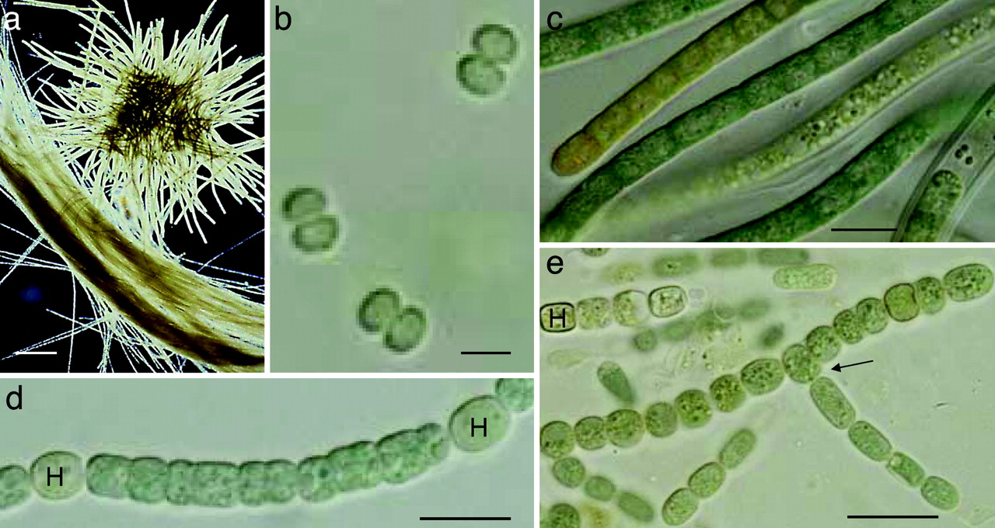
Synthetic Biology with Cyanobacteria
Cox PA, Banack SA, Murch SJ, et al. Diverse taxa of cyanobacteria produce beta-N-methylamino-L-alanine, a neurotoxic amino acid. Proc Natl Acad Sci USA. 2005;102(14):5074-8.

Slide 3
Synthetic Biology with Cyanobacteria
Biofuels
Biodiesel
Free fatty acids
Alkanes & alkenes
Ethanol
Butanols
Cox PA, Banack SA, Murch SJ, et al. Diverse taxa of cyanobacteria produce beta-N-methylamino-L-alanine, a neurotoxic amino acid. Proc Natl Acad Sci USA. 2005;102(14):5074-8.

Slide 4
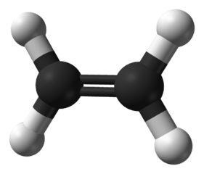
Synthetic Biology with Cyanobacteria
Biofuels
Biodiesel
Free fatty acids
Alkanes & alkenes
Ethanol
Butanols
Commodity chemicals
Ethylene
Isoprene
Acetone
Plastics
Openclipart.org
Cox PA, Banack SA, Murch SJ, et al. Diverse taxa of cyanobacteria produce beta-N-methylamino-L-alanine, a neurotoxic amino acid. Proc Natl Acad Sci USA. 2005;102(14):5074-8.
Wikimedia Commons

Slide 5
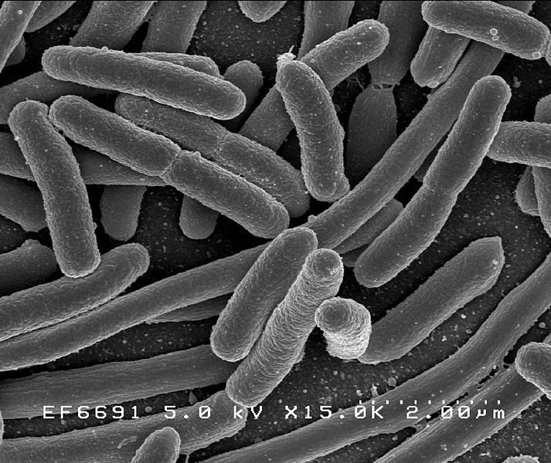
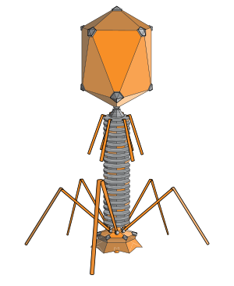
Tools lagging for cyanobacteria
Rely on E. coli and coliphages for tools and systems
Rocky Mountain Laboratories, NIAID, NIH
About.com

Slide 6
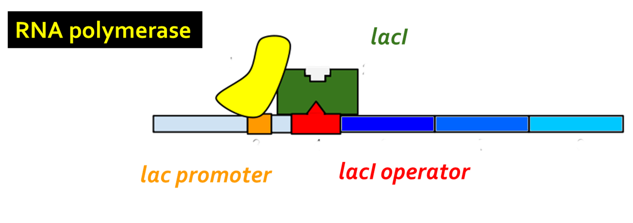
lac operon and lacI repressor
Genes of interest
Adapted from http://en.wikipedia.org/wiki/File:Lac_Operon.svg

Slide 7
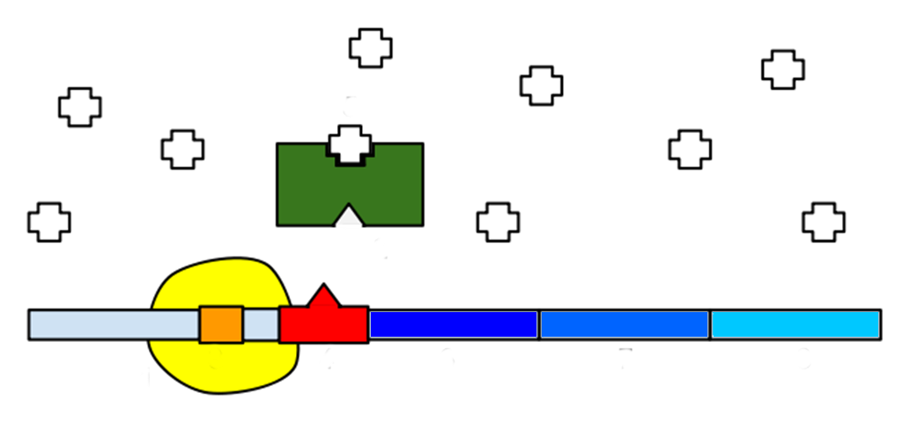
lac operon and lacI repressor
IPTG
Adapted from http://en.wikipedia.org/wiki/File:Lac_Operon.svg

Slide 8
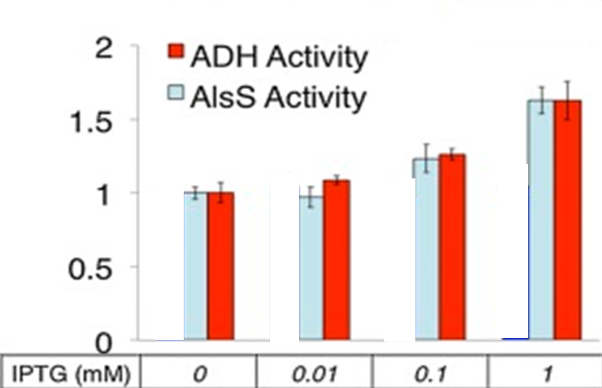
lac repression “leaky” in cyanobacteria
Oliver et al 2013
Expression of “repressed” genes in absence of IPTG
3 magnitudes of IPTG only changed activity by 1.6
Oliver JW, Machado IM, Yoneda H, Atsumi S. Cyanobacterial conversion of carbon dioxide to 2,3-butanediol. Proc Natl Acad Sci USA. 2013;110(4):1249-54.

Slide 9
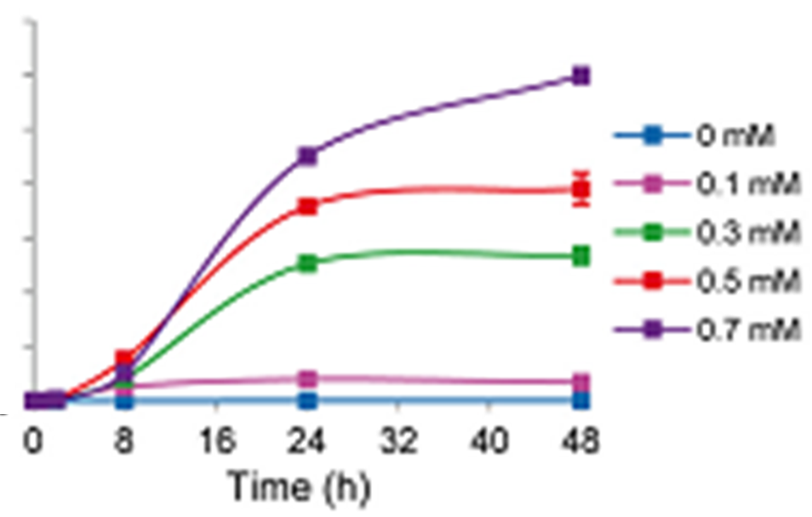
Metal Regulated Expression
Gomez-santos et al 2012
Faced similar problem in Myxococcus xanthus
Created plasmids with gene expression induced by copper concentration
Cu Conc.
Gene Product Activity
Gómez-santos N, Treuner-lange A, Moraleda-muñoz A, et al. Comprehensive set of integrative plasmid vectors for copper-inducible gene expression in Myxococcus xanthus. Appl Environ Microbiol. 2012;78(8):2515-21.

Slide 10
SmtB repressor protein
Similar to lacI but for zinc instead of sugar
Divergently blocks both SmtA zinc neutralizer and itself to maintain zinc homeostasis
Zn
Zn
RNA polymerase
SmtB
smtB
smtA
smtB
operator
smtA

Slide 11
SmtB repressor protein
Similar to lacI but for zinc instead of sugar
Divergently blocks both SmtA zinc neutralizer and itself to maintain zinc homeostasis
RNA polymerase
Zn
Zn
SmtB
smtB
smtA
smtB
operator
smtA

Slide 12
SmtB repressor protein
Similar to lacI but for zinc instead of sugar
Divergently blocks both SmtA zinc neutralizer and itself to maintain zinc homeostasis
Zn
Zn
SmtB
RNA polymerase
smtB
smtA
smtB
operator
smtA

Slide 13
Proposal
Create a plasmid vector for cyanobacteria with gene expression regulated by SmtB and induced by the addition of zinc to serve as replacement for lac operon based plasmids.

Slide 14
Sequence Parts for PsmtA
-10
ATG… genes of interest
EcoRI
BamHI
SalI
SmtB Binding Site
smtA
RBS
Transcription
Start site

Slide 15
Plasmid Design
PsmtA
EcoRI
BamHI
HindIII
Replication origin
SalI
gene(s) of interest
Transcription terminator
Streptomycin resistance
XbaI
SalI
EcoRI

Slide 16
Plasmid Design
PsmtA
EcoRI
BamHI
HindIII
SalI
Homologous recombination sequence
gene(s) of interest
Transcription terminator
Streptomycin resistance
XbaI
SalI
EcoRI

Slide 17
Experimental Plasmid
PsmtA
EcoRI
BamHI
HindIII
Replication origin
SalI
luxA
Transcription terminator
Streptomycin resistance
luxB
XbaI
SalI
EcoRI

Slide 18
Gibson Assembly
No restriction enzymes or secondary hosts
Premade primers with matching 5’ and 3’
mix with endonuclease, DNA polymerase and ligase in single step
5’
3’
3’
5’
5’
3’
3’
5’

Slide 19
Gibson Assembly
Assemble complex plasmid without restriction enzymes or secondary hosts
Premade primers with matching 5’ and 3’
mixed with endonuclease, DNA polymerase and ligase in single step
endonuclease
5’
3’
3’
5’
5’
3’
3’
5’

Slide 20
Gibson Assembly
Assemble complex plasmid without restriction enzymes or secondary hosts
Premade primers with matching 5’ and 3’
mixed with endonuclease, DNA polymerase and ligase in single step
Heat to 75° C
5’
5’
3’
3’
3’
3’
5’
5’
Strands anneal

Slide 21
Gibson Assembly
Assemble complex plasmid without restriction enzymes or secondary hosts
Premade primers with matching 5’ and 3’
mixed with endonuclease, DNA polymerase and ligase in single step
Cool to 50° C
DNA ligase
5’
3’
3’
5’
DNA polymerase

Slide 22
Gibson Assembly
Assemble complex plasmid without restriction enzymes or secondary hosts
Premade primers with matching 5’ and 3’
mixed with endonuclease, DNA polymerase and ligase in single step
5’
3’
3’
5’

Slide 23
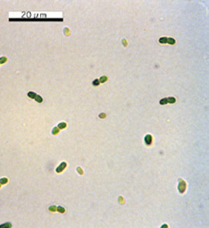
Transformation
Synechococcus sp. PCC 7002 capable of natural transformation
Does not required electric shock, freezing, chemicals
Has exonuclease in membrane. Only takes linear DNA
Plasmid must be digested with single restriction enzyme first
Reforms into circle once within cell
microbewiki.kenyon.edu/index.php/Synechococcus

Slide 24
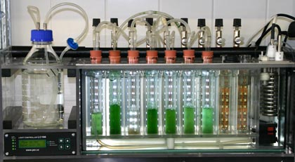
Transformation
Cultures incubated overnight with digested plasmid
Cultures centrifuged, spread over plate containing antibiotic
Incubated until colonies visible
Select colonies. Repeat steps 2 and 3 several times.
Inoculate liquid cultures
qubitbiology.com

Slide 25
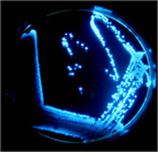
Measurement
Bacterial luciferase used as reporter gene
Active Bioluminescence
Oxidizes n-decanal, long chain alcohol
Cyanobacteria glow red under UV light, interferes with GFP
http://en.wikipedia.org/wiki/File:Biolumplate.jpg

Slide 26
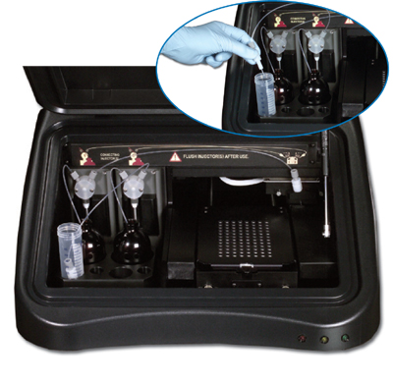
Measurement
Liquid cultures each exposed to varying concentrations of Zn²⁺
0.0 μ M to 2.0 μM
Luciferase activity measured
solution of n-decanal to each culture
luminometer measures strength of glow
promega.com

Slide 27
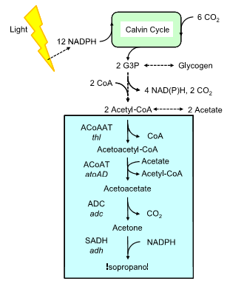
Applications
PsmtA
EcoRI
BamHI
HindIII
SalI
thl
atoAD
Kusakabe T, Tatsuke T, Tsuruno K, et al. Engineering a synthetic pathway in cyanobacteria for isopropanol production directly from carbon dioxide and light. Metab Eng. 2013;
adh
XbaI
adc
SalI

Slide 28
Control Multiple Genes w/ Multiple Metals
SmtB / ArsR family of repressor proteins
Similar structure and binding domains
Each affects different metal
Enzyme A
Enzyme B
Enzyme C
Openclipart.org

