Slide 1
Determination of host-associated bacterial communities
In the rhizospheres of maize, acorn squash, and pinto beans

Slide 2
Host-associated microbial communities
Eukaryotes play host to large and complex microbial communities
In humans, for instance, 90% of the cells are accounted for by the host-associated microbes
These communities have a symbiotic relationship with the host; the health of the host is dependent upon the capabilities of the microbes and the populations in some ways reflect the health of the host.

Slide 3
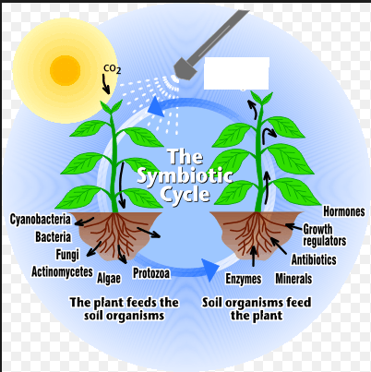
Rhizosphere symbiosis
In plants, much of the host-associated microbial communities lies in the rhizosphere - soil immediately surrounding the roots

Slide 4
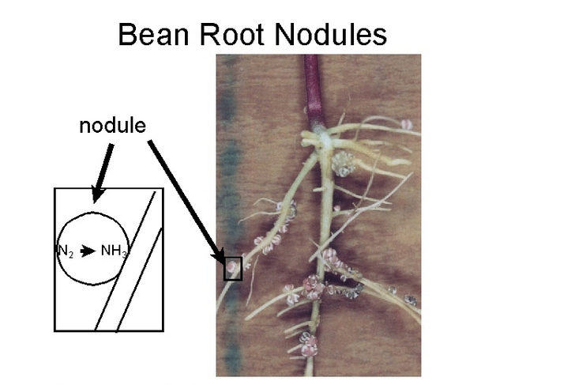
Nitrogen fixing in legumes
Well known example are bacteria which form nodules on legume roots, move in, and fix nitrogen

Slide 5
Potential
Understanding and controlling host-associated bacterial communities could provide alternative ways to treat crops to avoid chemicals that do collateral damage.
This study is intended to try to identify which of the bacterial present in various rhizosphere are host-associated.

Slide 6
How to identify different bacteria?
Common method is TaqMan qPCR. Makes use of universal primers for amplification and fluorescent probes within the amplified region specific to particular taxa.

Slide 7
FRET
Probe does not fluoresce while intact due to the proximity of the quencher at the end of the chain

Slide 8
If the probe attaches to a matching RNA segment, it is released during PCR amplification and the reporter is free to fluoresce indicating the presence of the sequence sought.

Slide 9
Universal primer?
In order for this to work, universal primer needed.
16S rRNA often used as the PCR region of choice because it is well-conserved within - and sometimes across - species. Primers available for bacterial 16S PCR are well known and often used.

Slide 10
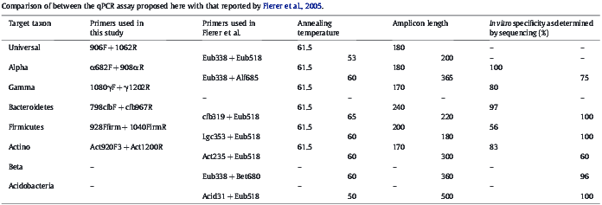
Need taxa-specific probes
Pobes tested by Fierer and Gregoris experiments

Slide 11
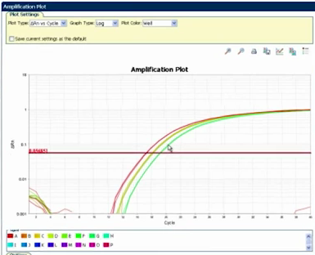
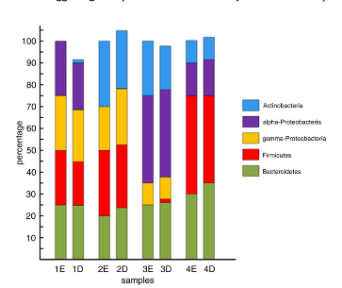
Plot fluorescence for relative abundance
Probes will reveal relative amounts of bacterial content.

Slide 12
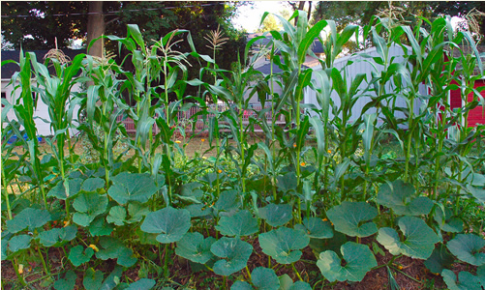
Three sisters
Pre-Columbian American agricultural technique. Plant three complementary crops – one ground cover (squash), one legume (bean), and one tall grain the beans can climb (maize)

Slide 13
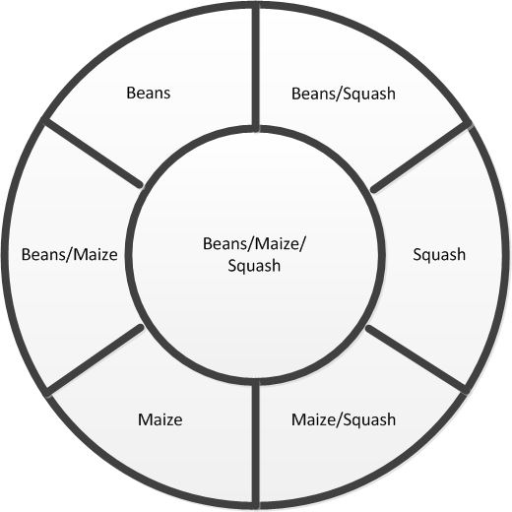
Experimental Bed
Samples will be taken and analyzed before planting to quantify bacteria without hosts present
Beds will be planted – maize, squash, bean, maize/bean, maize/squash, bean/squash, maize/bean/squash

Slide 14
Comparing relative quantification
Within each biom, relative quantities will be calculated using qPCR
Relative quantities will be compared with the “unhosted” samples and with the relative quantities from other beds to see how the hosts affect total and relative bacterial populations

Slide 15
Further studies
The idea behind the experimental bed is to add to the study over years
Other identical beds could be made in different locations with different soil and environmental conditions but same hosts
Bacteria could be introduced to see impact
Environmental factors such as nutrient levels, temperature, moisture, pH, salinity could be factored in
Charcoal (in the vein of tera preta) could be introduced

Slide 16
Bacterial meta-genomic sequencing
High-throughput total genome sequencing should be incorporated
Meta-genomic data could be used to partially identify bacteria closer to the species
qPCR data may assist in partial sequencing of the bacteria
Meta-genomic data itself may wind up being more important than the speciation

