Slide 1
Using A Tyrosine-Kinase inhibitor to regulate JNK pathways and see its effect as a possible treatment for Parksinson’s Disease
By: Sobi Abbasi

Slide 2
Parkinson's Disease (PD)
Parkinson’s disease (PD) is one of the most common neurological disorders
Affecting over approximately one million people in North America
characterized by the loss of dopaminergic neurons

Slide 3
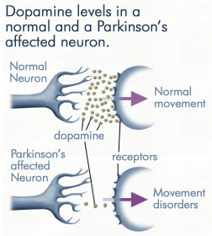

Slide 4
PD (cont)
What are Dopaminergic Neurons?
Loss of Neurons caused by programmed cell death
MPTP (1-methyl-4-phenyl-1,2,3,6-tetrahydropyridine)
Used to simulate PD in non human models
What MPTP Looks like
Taken from Wikipedia

Slide 5
What will I focus on?
For PD, I will focus on the Cell Death of Neurons
Xia et al (2001) claims apoptosis and JNKs play important role in PD.

Slide 6
What is JNK?
Stands for c-Jun N-terminal kinases
Is a stress activated protein Kinase
Identified as kinases that bind and phosphorylate c-Jun
c-Jun is a protein itself is a protein
Has 10 isoforms
JNK 1, JNK2, and JNK 3
is a Mitogen-activated protein

Slide 7
What are Mitogen-activated Proteins?
Mitogen-activated protein composed of three kinases
Form a sequential activation pathway
MAPK, MAPKK, and MAPKKK
JNK belongs to MAPK family
Phosphorylates specific serines and threonines on target protein substrates
This in turn regulates cellular activities like apoptosis!!

Slide 8
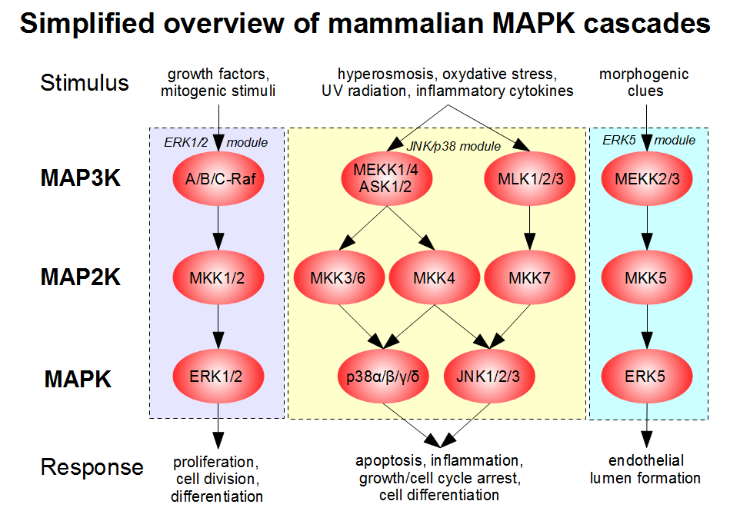

Slide 9
JNK and PD
Can Cell Apoptosis be regulated somehow through JNK?
Scientists are working on this and found some inhibitors that may provide an answer
SP600125
CEP-1347/KT-7515⁷

Slide 10
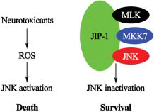
Adapted from Peng et Al

Slide 11
My Proposal
Is it possible to use a Tyrosine Kinase inhibitor known as Gefitinib to inhibit JNK?
A tyrosine kinase is an enzyme that can transfer a phosphate group from ATP to a protein in a cell.
Chose Gefitinib due to its ability to interrupt cell signaling

Slide 12
Experiment
Would be using mice to and Simulating PD onto them
Split the mice into three groups.
One with Gefitinib
One with SP600125
And a control group
Once experiment is done, neurons should be counted to see if there was in an increase or decrease.

Slide 13
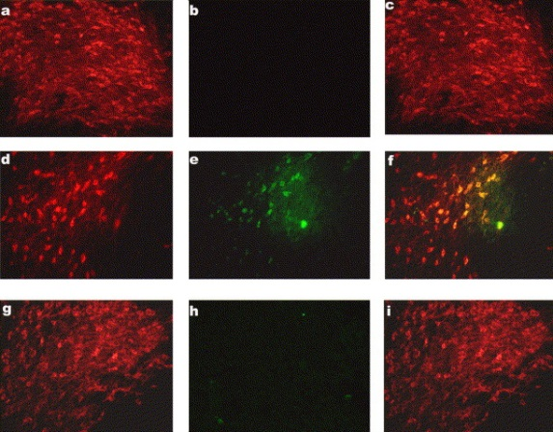
Immunohistochemistry
Immunohistochemistry refers to the process of detecting antigens or proteins in a tissue section by using antibodies
Specific antibodies are used
This is what the results will be look like

Slide 14
Discussion
Want to see a change in levels of neurons.
Was Apoptosis affected?
This will give me an idea if Gefitinib did anything
This experiment might be a little too much of a reach

