Slide 1
Analyzing Sarcasm in Tweets
Sydney Mabry
Dr. Bridget McInnes

Slide 2
Finding Sarcastic Tweets
@Microsoft Is it normal that it takes hours to check the email name for creating an microsoft account? 2nd try!
Looks like we're getting the heaviest snowfall in five years tomorrow. Awesome. I'll never get tired of winter.

Slide 3
Data
Skewed set:
100 sarcastic tweets and 491 non-sarcastic tweets
Non-skewed set
100 sarcastic tweets and 100 non-sarcastic tweets
430871355035119617 TS111209 null 1.0 @NickKlopsis c'mon man, you HAVE to take a side...#sarcasm
434472369948991488 TS111210 positive 1.0 More snow tomorrow Wooooooooooooooo! #sarcasm @Taggzzz @SchismV @frisky_ferret @ThunderDramon @XerxesWuff
523094999802863616 TS111420 neutral 0.2 It's October 17th and I just saw a Christmas commercial...
621375187255083008 TS113870 null 0.04 Today only is Amazon Prime Day, which offers more deals than Black Friday! If you plan to shop, don't forget to... http://t.co/NAr3TbYeMd

Slide 4
Method
WEKA
Results:
Precision
Recall
F-measure
Makes a model based on the features
Tweets

Slide 5
Features of a Tweet
Tweet:
So excited for snow #SnowOnTuesday
Unigrams:
So
excited
for
snow
Bigrams:
So excited
excited for
for snow
Hashtags:
#SnowOnTuesday
Label:
sarcastic

Slide 6
Method
Make a file to send to Weka
Determining if the tweets contain words listed in %docWords
@RELATION tweet_sentiment_train
@ATTRIBUTE wed NUMERIC
@ATTRIBUTE wednesday NUMERIC
@ATTRIBUTE week NUMERIC
@ATTRIBUTE weekend NUMERIC
@ATTRIBUTE well NUMERIC
@ATTRIBUTE were NUMERIC
@ATTRIBUTE label {sarcastic, not_sarcastic}
@DATA
0,1,1,1,0,0,not_sarcastic
1,0,0,0,0,1,sarcastic
0,1,0,1,0,0,sarcastic
0,1,0,1,0,1,not_sarcastic
1,0,1,0,1,1,sarcastic
@RELATION tweet_sentiment_test
@ATTRIBUTE wed NUMERIC
@ATTRIBUTE wednesday NUMERIC
@ATTRIBUTE week NUMERIC
@ATTRIBUTE weekend NUMERIC
@ATTRIBUTE well NUMERIC
@ATTRIBUTE were NUMERIC
@ATTRIBUTE label {sarcastic, not_sarcastic}
@DATA
0,0,0,1,0,0,not_sarcastic
1,0,0,1,0,0,sarcastic
0,0,0,1,1,0,not_sarcastic

Slide 7
Evaluation Methodology
Split data into 10 buckets
9 buckets train, 1 bucket tests
Gathered all the attributes in the tweets – hash table
Attributes from the training buckets would go in %docAtts
Perl module
Hash table of attributes
Bucket

Slide 8
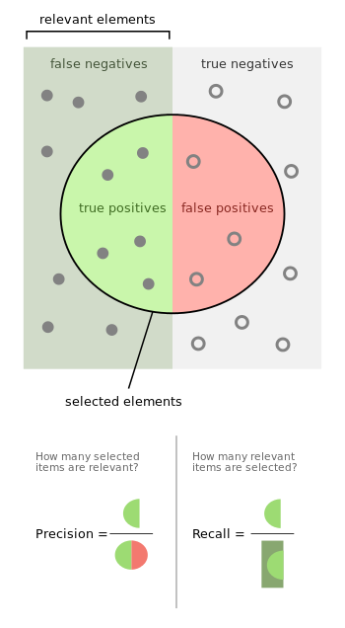
Evaluation
Precision Recall F-Measure Class
0.800 0.571 0.667 sarcastic
0.727 0.889 0.800 not_sarcastic
Weighted Avg.
0.759 0.750 0.742

Slide 9
Results
Skewed:
Getting around 87% accuracy when using unigrams
Regardless of other attributes
Without unigrams it is around 84% accuracy
Non-skewed:
Ranges from 85%-91% accuracy when using unigrams and other attributes
Without using unigrams it is around 77% accuracy

