Slide 1
Project Planning

Slide 2
Project Defined
A temporary piece of work with a finite end date undertaken to create a unique product or service.

Slide 3
School Projects

Slide 4
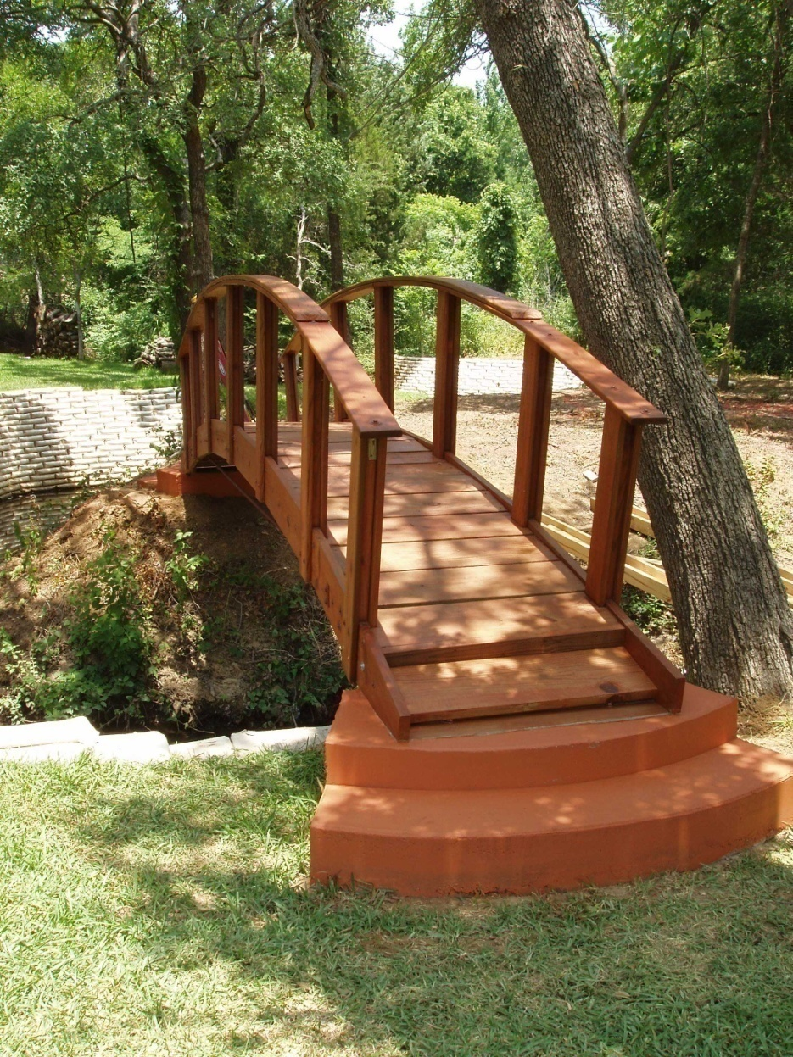
Home Projects

Slide 5
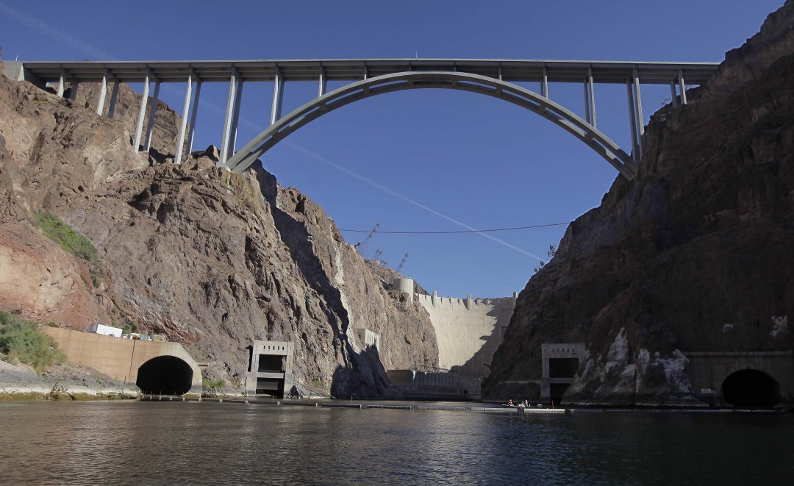
Work Projects

Slide 6
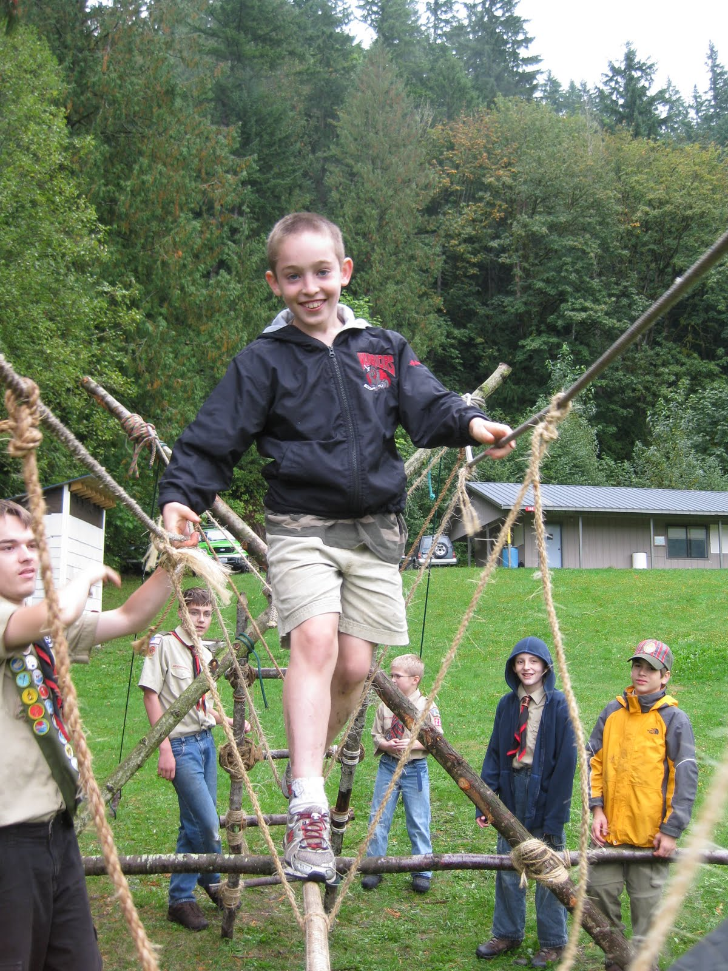
Scout Projects

Slide 7
Wood Badge & Project Planning
Patrol Project on weekend 2
Conservation Project Planning tomorrow
Ticket project(s)
Notes:
We are a diverse community
Not all projects are created equally
Each of our purviews are different

Slide 8
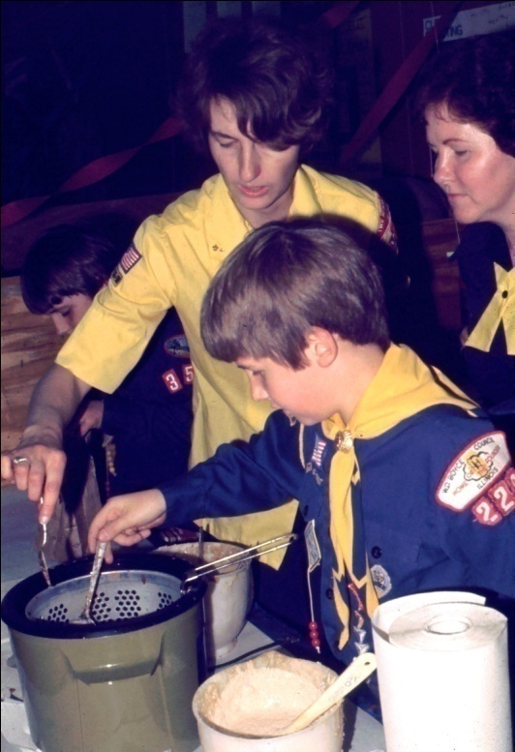
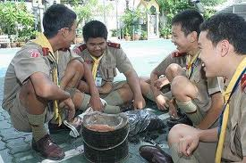
Key Ingredients to Successful Projects
will
knowledge & resources

Slide 9
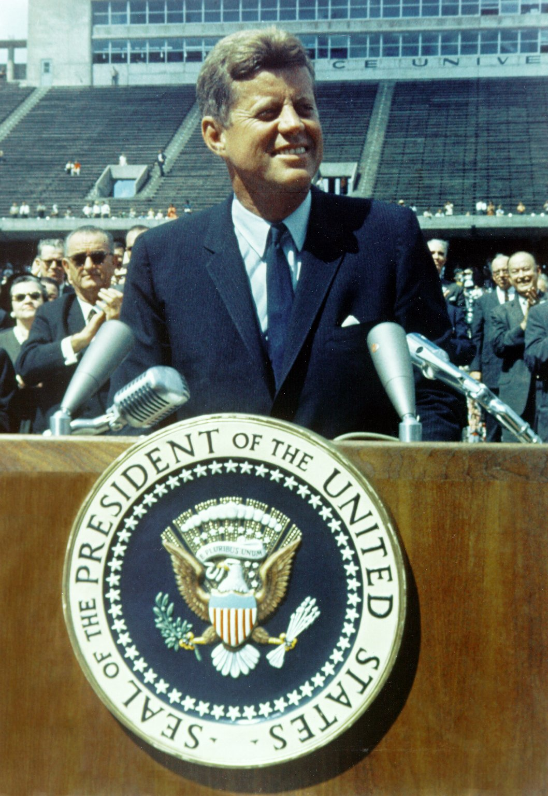
Notes:
Sept. 12, 1962

Slide 10
Project Planning Infomercial
IF THERE’S A ________,
THERE’S A _________!

Slide 11
Five Step to Project Planning
Project Overview
Activity List
Activity Plan and Assignments
Execute the Plan
Project Closeout
STEP 1
Project
Overview
STEP 2
Activity
List
STEP 3
Activity
Plan &
Assignments
STEP 4
Execute
The
Plan
STEP 5
Project
Closeout

Slide 12
Project Overview
Goals & Objectives
S – Specific
M – Measurable
A – Attainable
R – Relevant
T – Time-Based
1
2
3
4
5

Slide 13
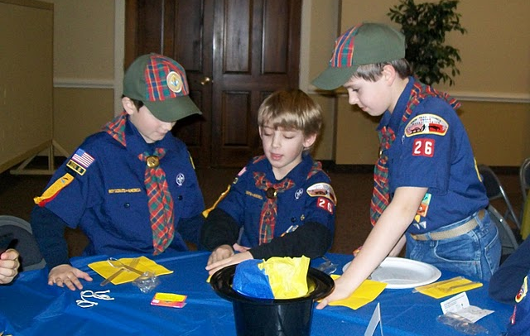
Project Overview
Goals & Objectives
Costs & Constraints
1
2
3
4
5

Slide 14
Project Overview
Goals & Objectives
Costs & Constraints
History
Lessons Learned
Start – Stop – Continue
After Action Review
1
2
3
4
5

Slide 15
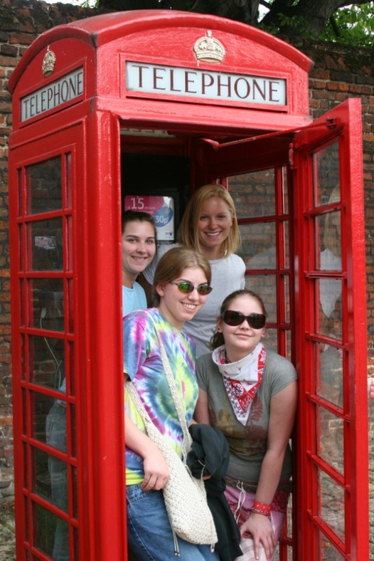
Project Overview
Goals & Objectives
Costs & Constraints
History
Approach
1
2
3
4
5

Slide 16
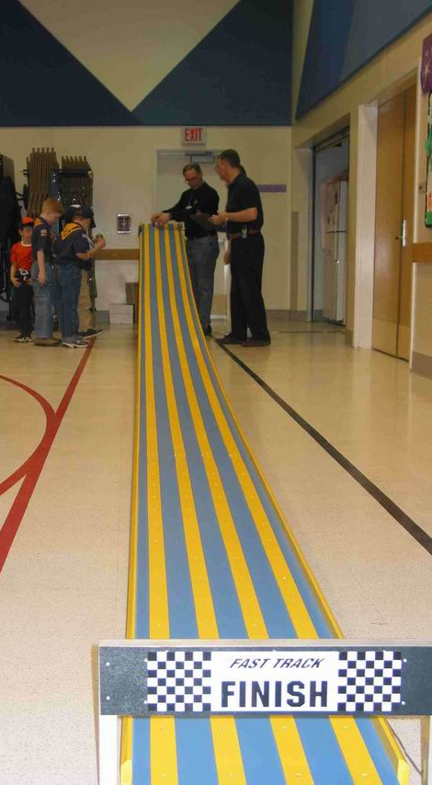
Project Overview
Goals & Objectives
Costs & Constraints
History
Approach
Assumptions & Risks
1
2
3
4
5

Slide 17
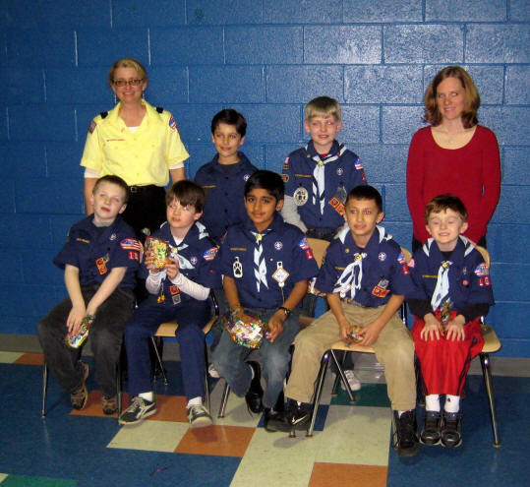
Project Overview
Goals & Objectives
Costs & Constraints
History
Approach
Assumptions & Risks
Measures of Success
1
2
3
4
5

Slide 18
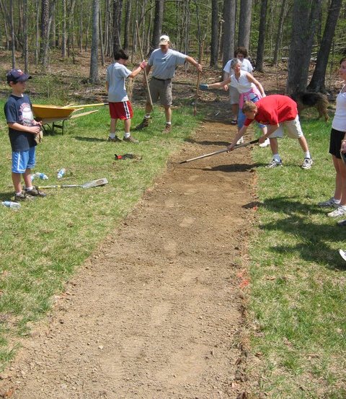
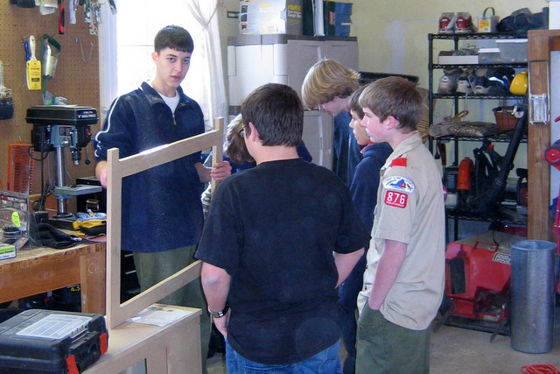
Project Overview
Goals & Objectives
Costs & Constraints
History
Approach
Assumptions & Risks
Measures of Success
Activity Trap & Scope Creep
1
2
3
4
5

Slide 19
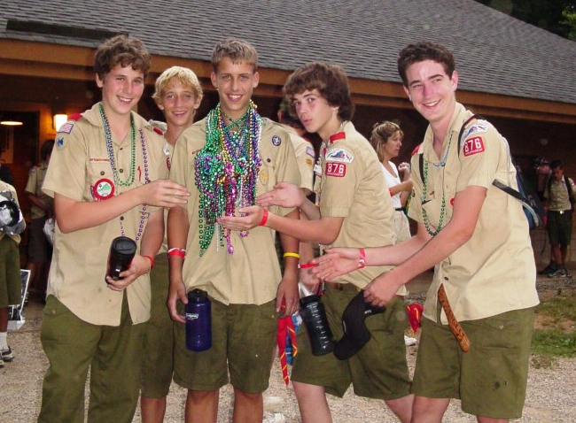
Project Overview
Goals & Objectives
Costs & Constraints
History
Approach
Assumptions & Risks
Measures of Success
Activity Trap & Scope Creep
One Page & Shared Vision
1
2
3
4
5

Slide 20
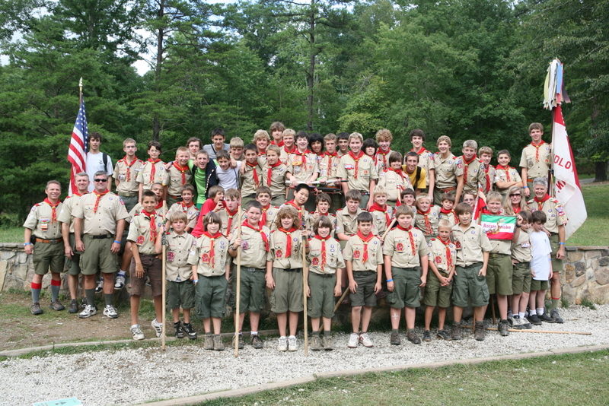
Activity List
Summer Camp
Logistics
Trans-portation
Program
Leader-ship
Admini-strative
Fees
Medical Forms
Equip-ment
High Adv.
New Scouts
Cracker Barrel
Merit Badges
Permission
Forms
1
2
3
4
5

Slide 21
Activity Plan
Assign team members to activities
Each Activity should be SMART…
Activity | Who | By When | Complete
Contract | Elaine | 11/15/10 | 9/15/10
Transportation | Steve | 6/15/11
Fees | Elaine | 7/1/11
Equipment | Al | 6/15/11
Leadership | H.C. | 5/15/11
Cracker Barrel | Dallas | 7/1/11
Merit Badges | Rachel | 6/15/11
1
2
3
4
5
Notes:
Training & Kick Off Explosions (popcorn kernel….team leader)
Marketing (exciting-dynamic)
Door to Door training (good EDGE instructor)
Show and Sell coordinator (salesman)
Finance manager (money manager/treasurer)
Logistics – pick up and delivery (truck & Strong back)

Slide 22
Work the Plan
Now is the time to let the team do its job!
A well-laid plan will help ensure a team is performin’ . . . not stormin’!
Don’t you love it when a plans comes together?
1
2
3
4
5
Notes:
Philmont Trek
Over a 1+ year long plan
-Lottery - Signup
-Training
-Conditioning & Prep Hikes
-Finance
-Fund Raising
-Equipment
-Pre-Philmont Activities
-Transportation/Logistics
-Celebration….we all made it!

Slide 23
Closing Out the Project
Recognize team members
Prepare After-action report
Start-Stop-Continue
1
2
3
4
5
Notes:
100th Anniversary
Projects? Jamboree???
Goals and objectives met?
Completed on schedule?
Lessons learned?
Ideas/recommendations for future projects

Slide 24
Take Home Message
Projects are everywhere
5 Steps to project planning
SMART Goals, Objectives & Activities
Where there’s a ……

Slide 25
Questions

Slide 26
Rocket Building Project
Professor Werner von Turner

