Slide 1
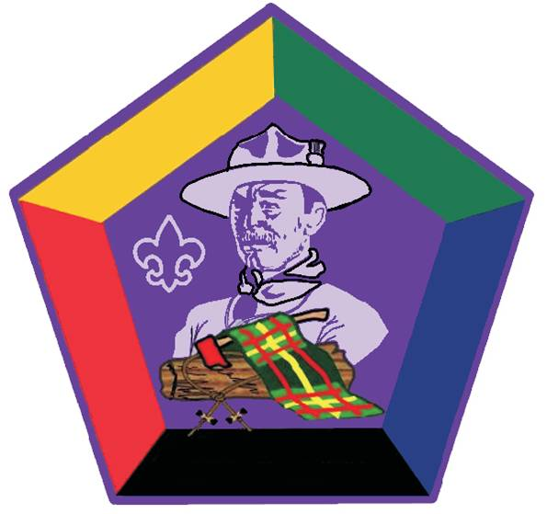
Bringing the values to Life:
Listening to Learn
Communication
Inclusiveness
Valuing People, Leveraging Diversity
Coaching & Mentoring
Leading to Make a Difference:
Leaving a Legacy
Tools of the Trade:
Project Planning
Leading Change
Decision Making & Problem Solving
Managing Conflict
Self-assessment
Models for Success:
Stages of Team Development
The Leading EDGE/The Teaching EDGE
Living the Values:
Values, Mission & Vision

Slide 2
Bringing the values to Life:
Listening to Learn
Communication
Inclusiveness
Valuing People, Leveraging Diversity
Coaching & Mentoring
Leading to Make a Difference:
Leaving a Legacy
Tools of the Trade:
Project Planning
Leading Change
Decision Making & Problem Solving
Managing Conflict
Self-assessment
Models for Success:
Stages of Team Development
The Leading EDGE/The Teaching EDGE
Living the Values:
Values, Mission & Vision

Slide 3
Bringing the values to Life:
Listening to Learn
Communication
Inclusiveness
Valuing People, Leveraging Diversity
Coaching & Mentoring
Leading to Make a Difference:
Leaving a Legacy
Tools of the Trade:
Project Planning
Leading Change
Decision Making & Problem Solving
Managing Conflict
Self-assessment
Models for Success:
Stages of Team Development
The Leading EDGE/The Teaching EDGE
Living the Values:
Values, Mission & Vision

Slide 4
Bringing the values to Life:
Listening to Learn
Communication
Inclusiveness
Valuing People, Leveraging Diversity
Coaching & Mentoring
Leading to Make a Difference:
Leaving a Legacy
Tools of the Trade:
Project Planning
Leading Change
Decision Making & Problem Solving
Managing Conflict
Self-assessment
Models for Success:
Stages of Team Development
The Leading EDGE/The Teaching EDGE
Living the Values:
Values, Mission & Vision

Slide 5
Bringing the values to Life:
Listening to Learn
Communication
Inclusiveness
Valuing People, Leveraging Diversity
Coaching & Mentoring
Leading to Make a Difference:
Leaving a Legacy
Tools of the Trade:
Project Planning
Leading Change
Decision Making & Problem Solving
Managing Conflict
Self-assessment
Models for Success:
Stages of Team Development
The Leading EDGE/The Teaching EDGE
Living the Values:
Values, Mission & Vision

Slide 6
Bringing the values to Life:
Listening to Learn
Communication
Inclusiveness
Valuing People, Leveraging Diversity
Coaching & Mentoring
Leading to Make a Difference:
Leaving a Legacy
Tools of the Trade:
Project Planning
Leading Change
Decision Making & Problem Solving
Managing Conflict
Self-assessment
Models for Success:
Stages of Team Development
The Leading EDGE/The Teaching EDGE
Living the Values:
Values, Mission & Vision

