Slide 1
Problem Solving and Making Decision
Bob Parker and
Charleen Walters
Troop Guides

Slide 2
Objectives
Determine the best method to make a decision
Use the 4 steps of problem solving to make a decision
Use strategies for group decision making to make a decision
Notes:
2 types of decisions
Immediate need – problem solving
Time to think – decision making

Slide 3
Problem Solving
Notes:
Can be quick
Can be longer based on situation
Works at all levels
Cubs – with parents
Boy and venture works with adults and youth

Slide 4
Patrol Backpacking
Notes:
On AT, getting dark need campsite now
Want boy leadership but…. Need to be set up before dark or it gets
Dangerous
Solicit responses from group on how you could accomplish this

Slide 5
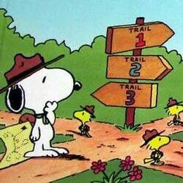
Step 1: Describe Problem
Notes:
Let group build list
Remind young group, first backpack
Good weather
What is needed for campsite
Water
Flat area
No deadfall

Slide 6
Step 2: Gather Information
Notes:
Information needed solicit from group
Geography
Park rules
LNT
# tents
Water
Communicate needed information

Slide 7
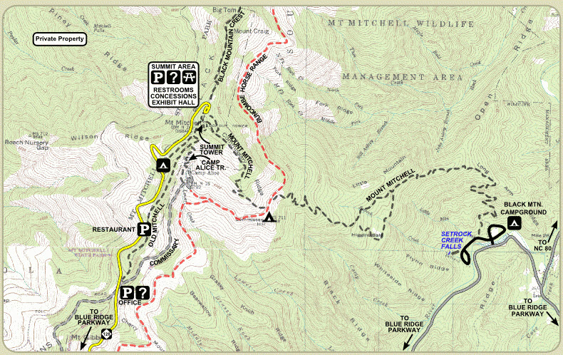
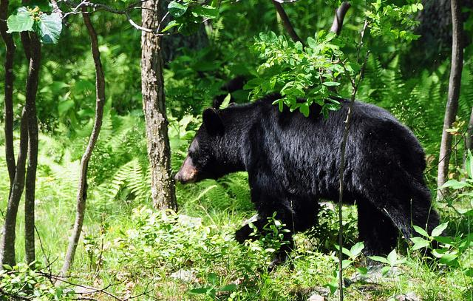
Step 3: Determine what is important
Notes:
What is important
From previous list

Slide 8
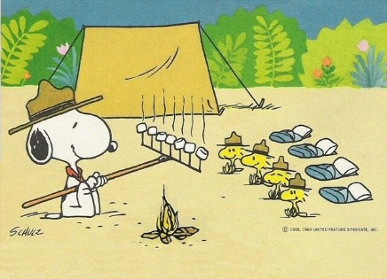
Step 4: Visualize Success
Notes:
Find a campsite
All sleep well ready for new day

Slide 9
Decision Making

Slide 10
Strategy 1: Brainstorming
Team, we need to decide which Trek we want to take on our upcoming Philmont Trip. Let’s start by talking about what you would like to do.

Slide 11
Strategy 2: Group Consensus
Team, good discussion. I am glad we decided to take the Fishing Trek. I think we are going to have fun.

Slide 12
Strategy 3: Multi-voting
OK, the list looks good but it seems like we cannot decide on the equipment we are taking. A vote is needed to decrease this list.

Slide 13
Strategy 4: Parking Lot
This issue is not part of the equipment. Put this to the side for later discussion.

Slide 14
Summary
Problem Solving
Describe the problem
Gather Information
Determine what is important
Visualize success
Decision Making
Brainstorming
Group Consensus
Multi-voting
Parking Lot

