Slide 1
Leading Change
Tony Easter and
Dave Ansell
Troop Guides
Notes:
Good morning
Im Dave Ansell Troop Guide for the Beavers and
Im Tony Easter, Troop Guide for the _____________________________________
Dave-
Tony -
Dave - Here something I bet you did not know. Click

Slide 2
CHANGE
HAPPENS
Notes:
Dave - Change Happens!
Here a few quotes about change:
Tony:
Dave:
Tony:
Dave:
Tony:
Dave: So,What do you do when Change Happens?
click

Slide 3
CHANGE
Notes:
Dave: You can be Fearful and Resist Change
click

Slide 4
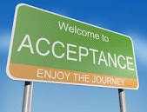
Notes:
Dave: You can Accept the change
click

Slide 5
Notes:
Dave: Or you can be the Leader of Change
click

Slide 6
Change is a valuable tool of leadership
When change is needed, a change leader can make it happen
When change is inevitable, a change leader can make it a positive experience
Notes:
Tony: Change can be a valuable tool for a Leader
click
A leader can help the team identify and make the necessary changes. Or
click
They can guide the team through the inevitable changes to achieve a positive result.
Now lets talk about the six steps for leading change

Slide 7
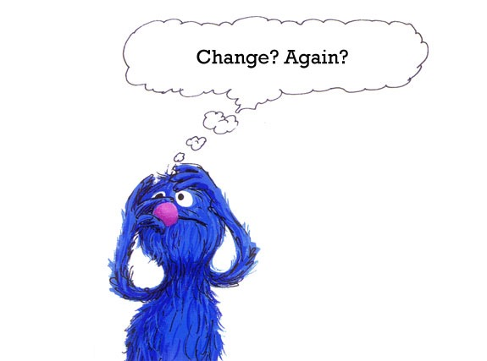
Notes:
Dave : Poor Grover. Change can be hard. No one really likes it.
Let’s give this a try. I want everyone to cross your arms.
Everyone got. Great!
Now I want your to switch your arms so that the opposite arm is underneath.
How does that feel? Awkward? Now that was just a subtle change, but it can really throw you off, can’t.
click

Slide 8
STEP 1
Recognize that change happens
Notes:
Dave : Step 1 is to recognize that change happens.
Anticipate the change is coming, even if it is a subtle change - recognize the it is going to happen whether you want it or not.
Accept the change and adapt to it.
And as it said in an earlier slide, Acceptance - Enjoy the journey!

Slide 9
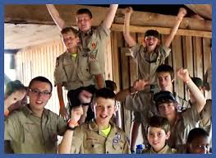
Notes:
Tony: To be successful in Leading Change you are going to have to get others on board for the changes
click

Slide 10
STEP 2
Empower others to help you lead change
Notes:
Tony: Step two is empowering other to help you lead change.
1-You will need to consider who else needs to be involved
2-You will need to explain the reasons the change
3- You will need to build relationships through shared experiences
4- You will build consensus
5- Finally you will have to manage expectations.

Slide 11
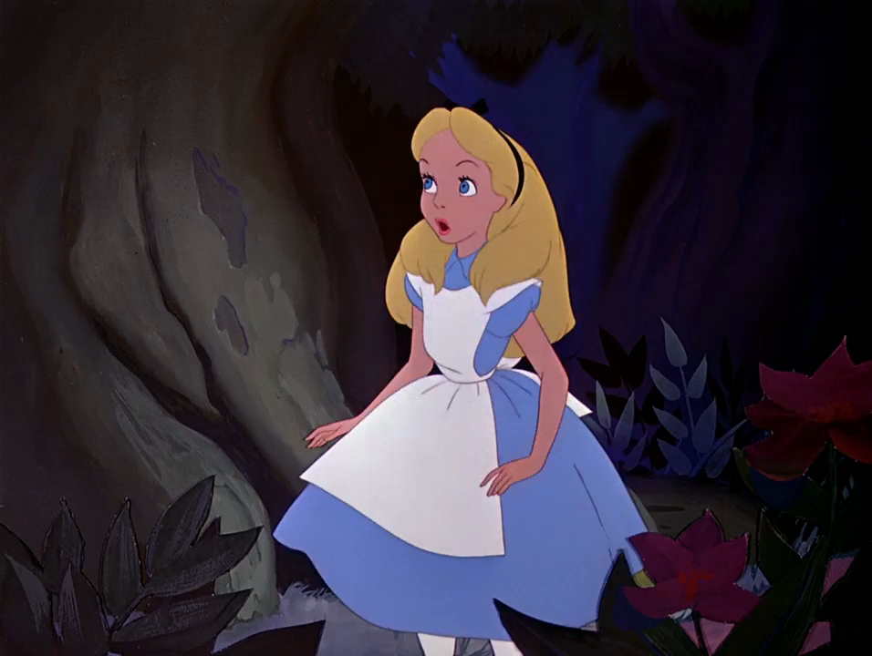
Notes:
Dave: Need play the Alice in Wonderland clip

Slide 12
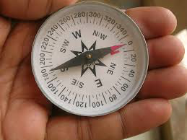
Notes:
Dave: To lead change we need to know where we are going. I had a County Administrator tell me one time that if we are going in 5 different directions we are not going in any direction.
click

Slide 13
Step 3
Lead change based on Values, Mission, and Vision
Notes:
Dave: That leads us to Step Three.
The tools for finding that direction and staying on course are vision and mission based on a clear sense of personal and organizational values.
As we learned on Day One with Les in the Values, Mission and Vision lesson,
Values are the moral compass, letting us know whether the changes we are considering are right or wrong (Values of Scouting)
Mission is the purpose
And Vision is our picture of future success
Vision allows us to visualize the end result and inspires us with the possibilities of what might be, like when we plant a small acorn we can envision the gentle giant it will become.

Slide 14
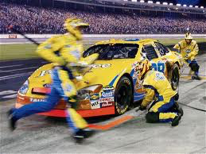
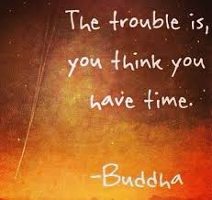
Notes:
Tony:
People need a compelling reason to change. Without urgency, great ideas may sit on the shelf for years.
(Click)

Slide 15
Step 4
Establish a Sense of Urgency
Notes:
Tony: Step four is to Establish a Sense of Urgency
The television was invented in the late 1930s, but it did not become a widespread technology until the 1950s. [what happened in the 50s to get it jump started]
The advent of aircraft carriers during WWII made the battleship all but obsolete, yet it would be half a century before the world’s navies fully adjusted to that fact.

Slide 16
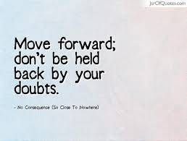
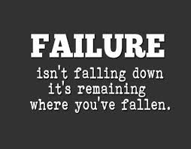
Notes:
Dave: (Pause a while to give everyone a chance to read)
As the Leader of Change there will be obstacles to overcome including yourself and others.
Click

Slide 17
Step 5
Move ahead, Regardless
Notes:
Dave: Step 5 is to Move Ahead, Regardless
“Is that a problem or is that an opportunity?”
Don’t let the obstacles become barriers. Figure out a way to move around them instead of just stopping.
Since there will always be obstacles, all you can do is think through as many scenarios to be prepared.
ONE of those obstacles may be people who are so resistant to change that you aren’t able to bring them along on the journey.
Encourage them, but move forward anyway.
Those things happen. It is one of the ways that groups reshape themselves to take advantage of inevitable change.
Half a step forward is better than no step or a step backward.

Slide 18
Notes:
Tony: So how can we get to Love It and not Fear it?
Click

Slide 19
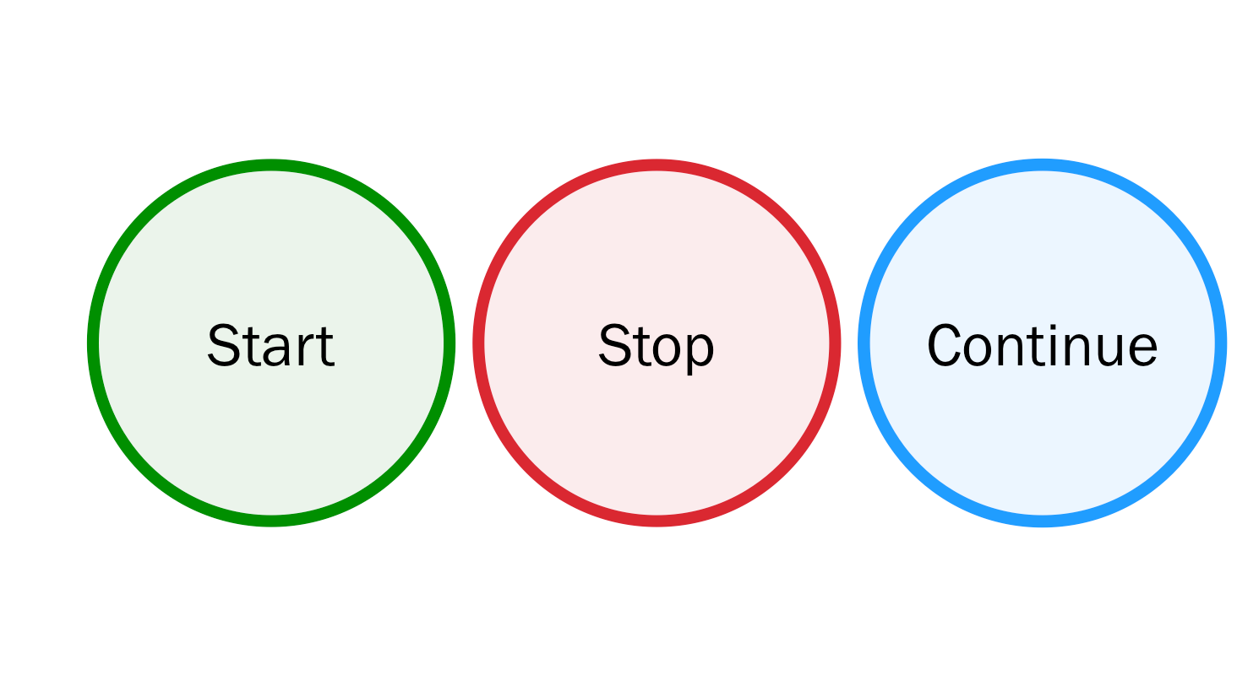
Step 6
Create a culture that embraces Change
Notes:
Tony: Step 6 is to create a culture that embraces Change.
How can we create a culture that embraces change?
Start-Stop-Continue presumes that changes will be made
Surveys show that you are willing to take feed back to get better

Slide 20
Step 6
Feedback is a Gift!
Notes:
Tony:
Feedback… because [ask for audience participation] “Feedback is a gift!”
- Samuel Smiles, a Scottish author, said:
We learn wisdom from failure much more than from success. We often discover what will do, by finding out what will not do; and probably he who never made a mistake never made a discovery.
- Help your group learn to love change!

Slide 21
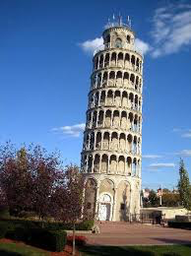
Exercise
Let’s Build a Tower
Notes:
Dave
Let’s build a tower! I know you’ve probably all done something like this before, but we’re going to throw a few twists in it… you know, changes! What would a good presentation be without demonstrating change?
We’re running a little short on time, so be prepared when you’re PL gets back to jump right in.
So, PLs need to come over and get instructions and building materials.
Give 12 skewers & tape. Tell them Patrol has 7 minutes to build a tower as tall as you can. Remember, a good change leader builds consensus…
start the clock
After 2:00 min, call PL back. While we’re “debriefing”, have TGs replace tape with plumber’s putty. [tape recall]
Send PLs back. At 4:00min mark, have TGs give straws to supplement skewers.
At 6:00 min mark, add time, give additional skewers and tape.
At 8:00 min mark give gum drops.

Slide 22
We Will Start In
1
0
5
4
3
2
1
0
0
9
8
7
6
5
4
3
2
1
0
9
8
7
6
5
4
3
2
1
0
9
8
7
6
5
4
3
2
1
0
9
8
7
6
5
4
3
2
1
0
9
8
7
6
5
4
3
2
1
0
9
8
7
6
5
4
3
2
1
0
0
1
0
0
Hours
Minutes
Seconds

Slide 23
We Will Start In
0
0
5
4
3
2
1
0
0
9
8
7
6
5
4
3
2
1
0
9
8
7
6
5
4
3
2
1
0
9
8
7
6
5
4
3
2
1
0
9
8
7
6
5
4
3
2
1
0
9
8
7
6
5
4
3
2
1
0
9
8
7
6
5
4
3
2
1
0
0
3
0
2
Hours
Minutes
Seconds

Slide 24
Exercise
Notes:
Tony
DEBRIEF
What were the instructions? Build a tower as tall as you can. Does everyone have a tower? Then you were all successful! Congratulations! You’re all winners, but let’s talk about what we learned along the way.
In this particular case, since this is “Leading Change”, you knew there’d be changes. It’s not always that obvious that change is coming. Some people say that “The only constant is change.”
PLs were encouraged to build consensus within the group. And then they were pulled away and others had to carry on the vision.
For our purposes, we had to impose a mission on you of building the tallest tower, but your vision and your values came together in the final product… [talk about differences between teams]
We gave you a limited time frame to complete your project. You often don’t get to choose your time frame. How did it feel when we gave you additional time?
The materials kept changing, the PLs left, but all the groups kept moving forward. We put lots of obstacles in your way. Was there any storming that slowed you down?
Here we are, we’re debriefing. Hopefully, given more time, your team would have been able to evaluate their progress and made more adjustments along the way. Feedback, self evaluations, and other tools help you review and foster that culture that embraces change.

Slide 25
Notes:
Dave:
In 2000, the summer olympics were held in Sydney Australia. An Aborigine woman ran in the 400 meter race.
Her Aboriginal ancestors had lived in Australia for thousands of years before European settlers arrived and forced them off their lands. Discrimination against the Aborigines became embedded in the Australian culture. As recent as two generations before the 2000 Olympics, Aborigine children could be taken from their families to be raised outside of their native traditions. As recent as 30 years before the Olympics, Aborigines still could not vote.

Slide 26
Notes:
Dave:
In the 2000 Olympics, here comes Cathy Freeman, a young lady, a young Aborigine lady, who crossed the finish line to 110,000 cheering fellow countrymen in the stadium and millions more throughout Australia for this Aborigine runner.

Slide 27
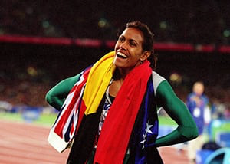
Notes:
Dave:
Kathy took her victory lap with her flag as is almost customary now days. Only Kathy took 2 flags with her, Australia and the flag of the Aborigine people.
This was a moment that forever changed the Australian culture for the better. But it was a change a long time in the coming. A gradual change, involving a great many people over a great many years.
Kathy Gold medal victory was won one step at a time. Australia's Vision of a fairer, freer nation, is being realized in the same way, many many small steps to change their culture and embrace the better world that lies beyond.

Slide 28
Notes:
Dave:
WE CANNOT BECOME WHAT WE NEED TO BE BY REMAINING WHAT WE ARE.

Slide 29
6 Steps to Lead Change
Notes:
Dave: So lets review

Slide 30
STEP 1
Recognize that change happens
Notes:
Dave : Step 1 is to recognize that change happens.
Anticipate the change is coming, even if it is a subtle change - recognize the it is going to happen whether you want it or not.

Slide 31
STEP 2
Empower others to help you lead change
Notes:
Tony: Step two is empowering other to help you lead change.
1-consider who else needs to be involved
2-explain the reasons the change
3- Use shared experiences to build relationships
4- build consensus
5- Finally manage expectations.

Slide 32
Step 3
Lead change based on Values, Mission, and Vision
Notes:
Dave: Step Three. Lead Change based on Values, Mission and Vision
Values are the moral compass, letting us know whether the changes we are considering are right or wrong (Values of Scouting)
Mission is the purpose
Vision allows us to visualize the end result and inspires us with the possibilities of what might be, like when we plant a small acorn we can envision the gentle giant it will become.

Slide 33
Step 4
Establish a Sense of Urgency
Notes:
Tony: Step four is to Establish a Sense of Urgency

Slide 34
Step 5
Move ahead, Regardless
Notes:
Dave: Step 5 is to Move Ahead, Regardless
Don’t let the obstacles become barriers. Figure out a way to move around them instead of just stopping.
ONE of those obstacles may be people who are so resistant to change that you aren’t able to bring them along on the journey. Encourage them, but move forward anyway.
Half a step forward is better than no step or a step backward.

Slide 35
Step 6
Create a culture that embraces Change
Notes:
Tony: Step 6 is to create a culture that embraces Change.
Continue the practice of Stop Start and Continue in all that you do.

Slide 36
Leading Change
See It
Feel It
Trust It
Notes:
Tony: As a Change Leader
You need to See the change
You need to Feel the change
And you need to Trust the change
If time is left, Tony and Dave will tell a little about why they are in Scouting and what Wood Badge means to them.
Thank you for allowing us to share this presentation with you.

