Slide 1
Stages of Team Development
Phil Victor & Charlotte Pemberton
Notes:
CHARLOTTE:
Thank you, John, for that wonderful introduction. And now for Stages of Team Development! Phil . . .

Slide 2
Overview
Illustrate stages of team development
View video depicting the stages of team development
A personal story illustrating stages of team development
Patrol Task
Notes:
PHIL:
In this presentation we will:
EXPLAIN the Stages of Team Development with an overview of each stage
DEMONSTRATE the stages with a video that illustrates each stage
GUIDE you through a personal story that involves a personal experience with the stages of team development
Finally, we will ENABLE you to relate these concepts to your own, personal experiences by finishing with a Patrol Task.

Slide 3
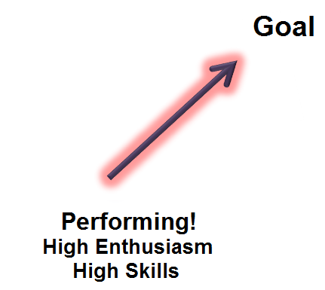
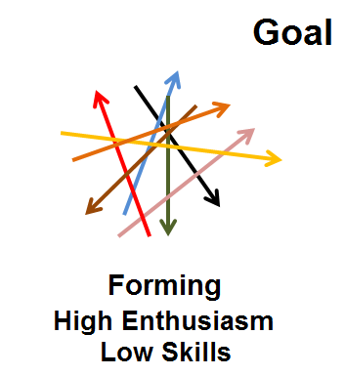
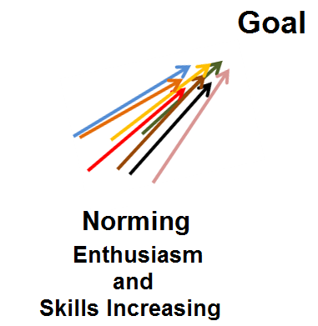
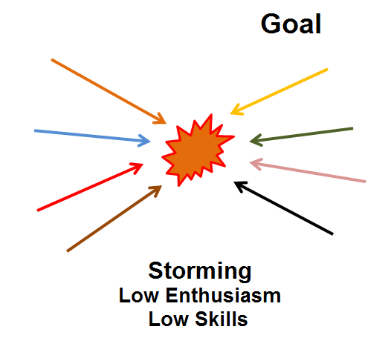
Stages of Team Development
Notes:
CHARLOTTE:
So what are the stages of team development?
The first stage is Forming – enthusiastic, not sure
The second stage is Storming – conflict, differences
The third stage is Norming – starting to come together,
seeing vision, goals
The fourth stage is Performing – pulling together as one

Slide 4
Forming “Pickup Sticks”
Notes:
PHIL:
Forming - stage 1
High dependence on leader
Little agreement on team aims
Individual roles, responsibilities are unclear.
The leader answer lots of questions about the team's purpose
Members test tolerance of system and leader.
Sound familiar??
You each are now part of a new team – your patrol.
Like the game of Pickup Sticks, individuals tossed together into a new team – your patrol.
Diverse group of individuals: different Scouting units, backgrounds, talents.
All eager, still getting to know each other – looking to your Troop Guide for guidance.

Slide 5
Forming
Notes:
PHIL:
“Friendly Guides”
Look familiar?
Everyone is friendly, cordial
But also apprehensive, sure of what to expect
The leader acts in a “Directing” or “Telling” mode in this phase.

Slide 6
Video: Forming
Notes:
PHIL:
“Set up-Forming”-Remember the Titans
Based on a true story that happen in Alexandria, Virginia in 1971.
TC Williams high school is being integrated for the first time.
A new coach, Herman Boone, has been appointed to take over the football team, replacing a highly successful and popular coach who has been demoted to assistant coach.
Boone is tough, opinionated, and the opposite of the old coach.
The movie tells the story tells of how the coaches and the players overcame their differences and became a team.
This clip depicts “Forming” stage.
It begins just prior to the first meeting some of the players and their new coach.
Watch the teams for indications of the “Forming” stage
RUN VIDEO STOP VIDEO

Slide 7
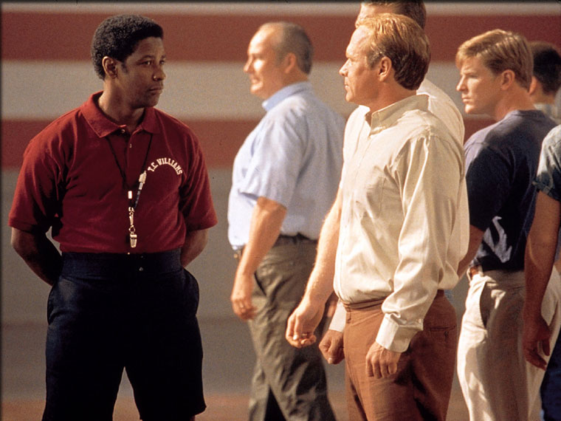
Video: Forming
Notes:
PHIL:
ASK THE PARTICIPANTS: Did you see . . . eagerness, high and unrealistic expectations, anxiety about how players will fit in, what demands will be placed on them?
Were the team members are unclear about expectations, rules, roles and goals?
Was there is a high dependence on the leadership figures for purpose and direction, and the new coach provides it quickly and clearly?
At this stage, team morale is high and team productivity is low.
Discuss Video-Forming –
Desire to be accepted by the others, and avoid conflict.
Serious issues and feelings are avoided
Gathering information about each other, and the scope of the task
This is a comfortable stage, but not much actually gets done.
What will Coach Boone do next? – The team meets and learns about the opportunities and challenges, agrees on goals, and begins to tackle the tasks.
Can this stage of development be avoided? – No, important because members get to know one another and make new friends.

Slide 8
Storming - “At Odds”
Notes:
CHARLOTTE:
Storming – the second stage
Reality not up to expectations
Difficulties arise – confusion, frustrations
Leadership is challenged – members compete of positions and control
Negativity sets in
Communications break down
May lead to splinter groups unless the leader takes action

Slide 9
Storming
Notes:
CHARLOTTE:
“Angry Guides”
Literally at each other’s throats.
Composure has broken down
Competing for group ranking
Leadership – coaching and mediating differences
'Selling' mode of leadership to bring around to goals

Slide 10
Video: Storming
Notes:
CHARLOTTE:
“Demonstrates Storming”
The scene features two players, both speaking on behalf of others. Clear factions have formed within the team, and morale is low. Look for signs of the “Storming” stage
RUN VIDEO
STOP VIDEO

Slide 11
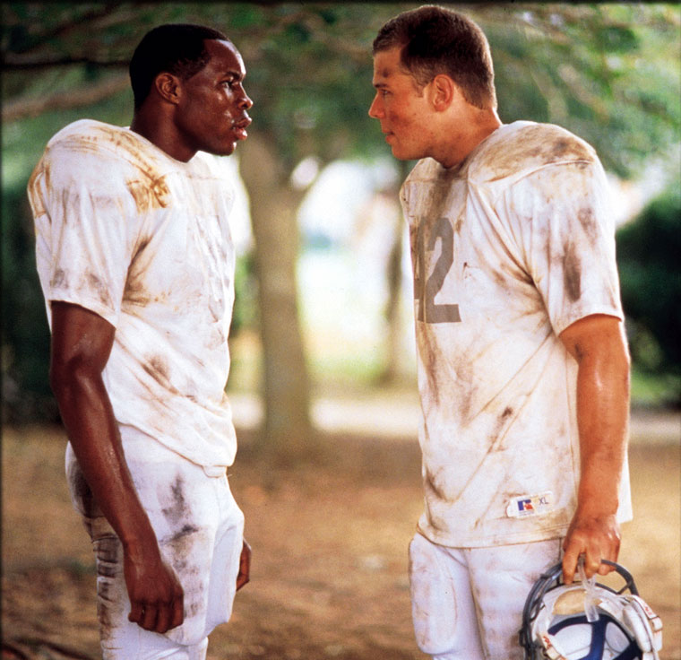
Video: Storming
Notes:
CHARLOTTE:
Ask the participants:
Did you see any difficulty working together, frustration, negativity, communication breakdowns, or dissatisfaction with leadership-in this instance with the team captain, not the coach?
Discuss Video-Storming –
Different ideas compete for consideration.
What problems they are really supposed to solve, how they will function independently and together and what leadership model they will accept?
Confront each other's ideas and perspectives.
In some cases storming can be resolved quickly. In others, the team never leaves this stage.
What needs to happen next? –
Leaders during this phase coach, mediate
Members raise differences openly to be resolved
Respected, not judged
Can you progress without “Storming”? Can you get stuck here?
Necessary, but unpleasant and even painful
Without tolerance and patience the team will fail. Destructive if allowed to get out of control.

Slide 12
Norming - “Coming Around”
Notes:
PHIL:
Norming - stage 3
Agreement and consensus
Members respond well to facilitation by the leader who leads in an Advising & Encouraging Style of Leadership.
Roles and responsibilities are clear and accepted.
Big decisions are made by group agreement.
Smaller decisions may be delegated
Commitment and unity is strong.
The team may engage in fun and social activities!
The team discusses and develops its processes and working style.
There is general respect for the leader and some leadership is shared by the team.

Slide 13
Norming
Notes:
PHIL:
“Eureka Guides”
Everyone is on the same page
The goals are in alignment within the group
Again, the leader Advises or Encourages

Slide 14
Video: Norming
Notes:
PHIL:
“Set up-Norming”-
Attitudes and morale are improving.
There is a willingness to share responsibility and control.
Look for signs of the Norming Stage
RUN VIDEO STOP VIDEO

Slide 15
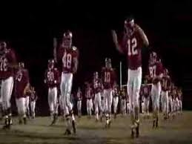
Video: Norming
Notes:
PHIL:
Ask the participants:
Did you see . . . positive feelings; team members valuing the differences
among themselves; team members start thinking “we” rather than “I”?
Norming –
Clearly the climate has changed.
There is increased commitment to purpose, roles, goals and working together.
The team has not necessarily transformed itself into a high-performing team yet, but it is coming around.
Team has one goal and an agreed upon plan
All members take responsibility and have the ambition to work for the success
What should the coaches do from here? –
Encourage them
The team will make most of the necessary decisions.
Will the team always remain at this level? –
Many long-standing teams go through these cycles many times as they react to changing circumstances.
For example, a change in team members from new people challenging the existing norms and dynamics of the team.

Slide 16
Performing - “As One”
Notes:
CHARLOTTE:
Performing - stage 4
More strategically aware; the team knows clearly why it is doing what it is doing.
The team has a shared vision
Leader advises, supports but team stands on its own feet
Team taken ownership of goals and makes own decisions
Disagreements occur but now they are resolved within the team positively
The team requires delegated tasks and projects from the leader.

Slide 17
Performing
Notes:
CHARLOTTE:
“Playful Guides”
The team no longer instructed
Leader supports and observes
Members might ask for assistance
personal and interpersonal development
Decision-making is delegated
Team takes ownership

Slide 18
Video: Performing
Notes:
CHARLOTTE:
“Set up-Performing”
Productivity and morale are high
Sense of pride and excitement in being part of the team
Primary focus is on performance. Commitment to continuous improvement.
Purpose and goals are clear.
The scene takes place at halftime of the biggest game of the season-and the Titans are losing the game.
RUN VIDEO STOP VIDEO

Slide 19
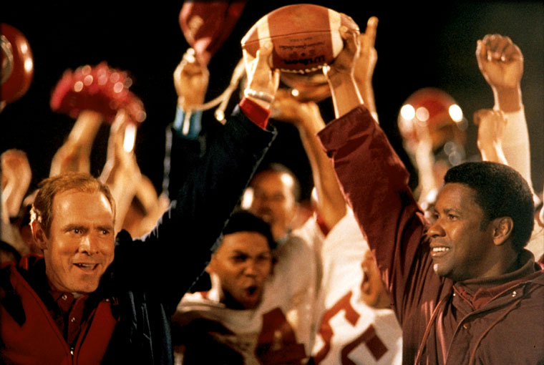
Video: Performing
Notes:
CHARLOTTE:
Ask the participants: Did they see . . . pride and confidence, open communication, shared leadership?
Performing-After halftime, the team had the confidence to take control of its own performance and destiny. The team went back out on the field, played like a high-performing team, and won the game.
Do all teams reach this level? –
It is possible to find ways to get the job done smoothly and effectively without inappropriate conflict or the need for external supervision.
By this time, motivated and knowledgeable. Competent, independent decision-making. Dissent handled appropriately
How is this type of team best lead? – delegation and observation.

Slide 20
Enthusiasm vs. Skill
Performing
HIGH
Forming
(supporting & observing)
ENTHUSIASM
(Directing &
Telling)
Norming
(Advising & encouraging)
Storming
(Mediating/
coaching)
LOW
LOW
SKILL
HIGH
Notes:
PHIL:
So let’s look at the Stages of Team development as a continuum.
Enthusiasm vs. Skill
If you are a leader leading a group, here are the leadership styles that should be used with each stage of Team Development.
You just played Front End Alignment where
Dramatically different leadership styles were used.
Directly effected how problems were solved and how the team worked together.
You experienced how that can affect the team.
So, as leader, how do you lead at each stage?
In the Forming Stage – High Enthusiasm/Low Skill (Directing & Telling and Explaining)
When moves to Storming Stage – Low Enthusiasm/Low Skill (Mediating & Coaching and Demonstrating)
As the come together, a team reaches the Norming Stage – Higher Enthusiasm/Higher Skill (Advising & Encouraging and Guiding)
When they become a Performing team – High Enthusiasm/High Skill (Supporting & Observing and Enabling)

Slide 21
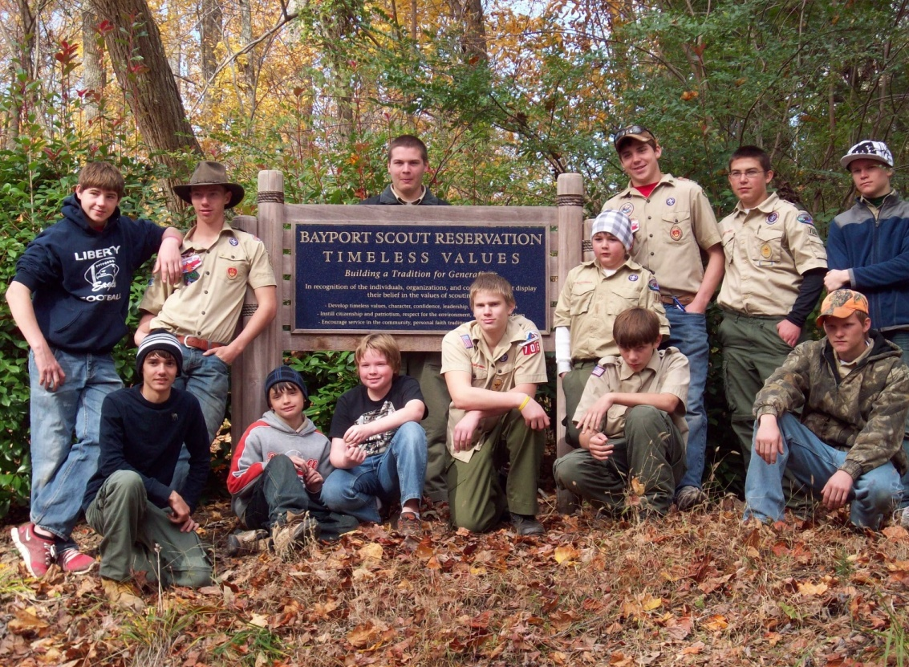
My Team Story
Notes:
Charlotte:
This is a story about a group of scouts from T706 in Montpelier that discovered a challenge held annually at Bayport Scout Reservation called Pumpkin Chunkin’.

Slide 22
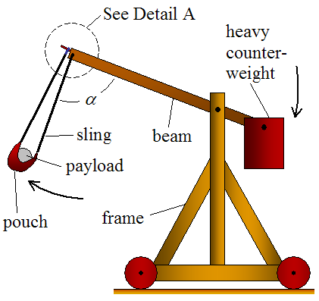
Troop 706 Had a Vision . . .
Notes:
These scouts had a vision – to build the biggest, baddest trebuchet possible and compete at the pumpkin chunkin’ contest. This is not something anyone in the troop had done before – in fact, they had never even been to the contest before – but it caught their imaginations. What boy wouldn’t want to throw a pumpkin in the air and watch it explode on the ground?

Slide 23
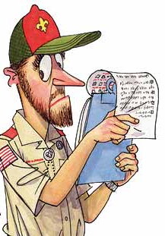
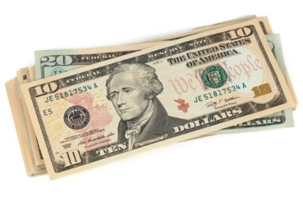
But there were difficulties . . .
Notes:
But there were challenges. First, they had to convince their scoutmaster that it was a scout sanctioned event and that it was safe. Then they had to convince the committee to fund the project even though it was not part of the program budget. Once they solved the conflicts from outside the group, they had to resolve some inside conflict. Of the older boys, who would be the leader? Who would create the design and build the machine? And the scoutmaster insisted that the younger scouts be included in some way at every stage.

Slide 24
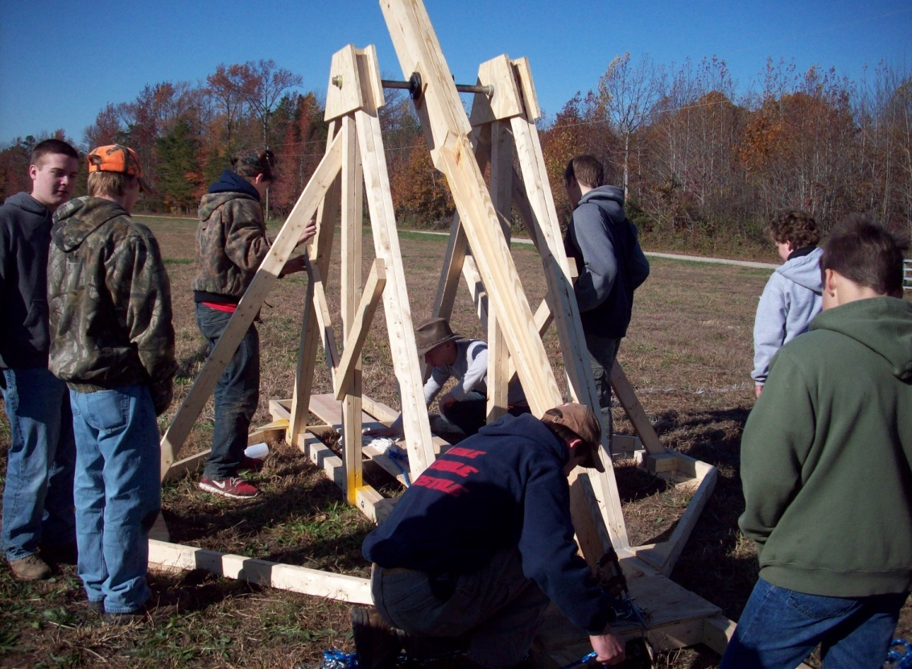
In Just Three Months . . .
Notes:
So this group of inexperienced scouts pulled together and in just 3 months convinced the committee to allocate $300, researched trebuchet designs, reviewed their model with a physics professor, acquired lumber, commandeered a wood working shop, built their trebuchet, and tested it by throwing stuff in a nearby cow pasture. They were ready for the big day! So they broke down the machine, loaded onto a tractor trailer bed, and headed to Bayport Scout Reservation.

Slide 25
On the Day of Competition . . .
No Tools!
No Sling!
No Helmets!
No Goggles!
Notes:
On the day of the competition, disaster struck! The box with all of their tools was nowhere to be found – it must have slid off the back of the trailer while in route!

Slide 26
Improvise . . .
Notes:
But the scouts had come too far to give up now! They begged and borrowed tools, helmets and goggles from neighboring competitors. The scout camp donated a basket ball net for the sling.

Slide 27
Strength . . .
Notes:
Without the pulley mechanism to attach the counterweights, the scouts used their own strength and ingenuity to work together and attach the weights to the arm. Each weight was 110 pounds and there were 6 of them.

Slide 28
The Competition . . .
Notes:
The competition was daunting. There were dozens of machines and some were much larger than T706’s. Each machine was allowed three practice shots, and it was an impressive group.

Slide 29
It Worked!
Notes:
When it was T706’s turn to shoot, their trebuchet worked! In spite of everything, it actually worked! Some of the other machines were shooting pumpkins everywhere, and others actually broke apart during the competition. But T706’s machine shot straight and true onto the field.

Slide 30
Improved!
Notes:
Not only did it work, but the scouts improved their distance by making adjustments to their machine and discovering that using pumpkins as close to the 10 lb limit as possible made a difference.

Slide 31
A Performing Team!
Notes:
So, did this team of scouts experience all the stages of forming, storming, norming and performing? You bet! Did they reach their goal of competing a the Pumpkin Chunkin’? Absolutely! Are they still a highly performing team? Well, until the next challenge and that is a story for another time.

Slide 32
Story Creation Task
Each patrol will create a story illustrating the stages of team development
The story may be based upon;
A patrol members experience
A historical event
A popular TV show
Each patrol will select a spokesperson
Notes:
PHIL:
Now each patrol
Will create a story
To illustrate the stages of team development.
The story may be based on a patrol member’s experience, or a historical event, movie, or some popular TV show.
The story should clearly illustrate the different stages of team development.
Each patrol select a spokesperson.
You have 6 minutes to create the story.

Slide 33
Story Time
Time Remaining:
Notes:
Pull patrol names from a hat to present story
Remind them to point out each phase they are encountering in their story.
6 mins to come up with story
DO AS MANY AS TIME ALLOWS
HOW MUCH TIME TO PRESENT??

Slide 34
SUMMARY
Leaders must understand and recognize the different stages of team development
Leaders must use appropriate strategies to move team through different stages.
Enthusiasm and Skill Level are a key parts of each stage of Team Development.
Notes:
CHARLOTTE:
Comment on patrols stories, and congratulations on your patrols understanding of the stages of team development.
We learned that:
Leaders must understand and recognize the different stages of team development
Leaders must use appropriate strategies to move team through different stages.
Enthusiasm and Skill Level are a key parts of each stage of Team Development.
By your understanding of the stages of development you are now better prepared to move forward with your patrol in the challenges facing you in the very near future. What stories will be developing over the course of your patrol development?

Slide 35
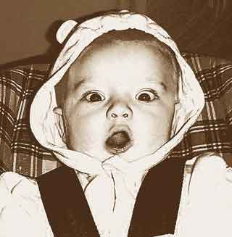
Expect the Unexpected
Notes:
PHIL:
There are caveats!
Understanding the Stages of Team Development enables us to:
Anticipate what a team is likely to experience.
Don’t be surprised, depressed or discouraged by various disagreements during the Storming Stage.
Don’t be alarmed if things don’t work out the way you thought they would.
It is completely normal to have disagreements and to Storm.
It’s part of your journey to becoming a highly performing team

Slide 36
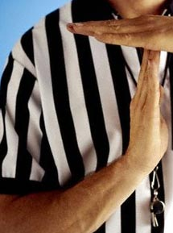
Prepare Ground Rules
Notes:
CHARLOTTE:
Understanding which stage our team is in will enable us to develop strategies to move our team through each phase.
For example, setting ground rules for engagement during conflicts in the Storming stage.

Slide 37
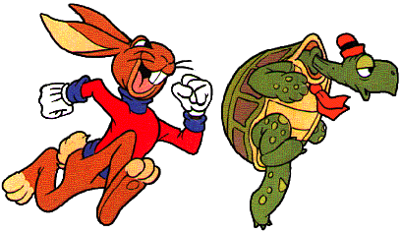
Sometimes Fast… Sometimes Slow
Notes:
PHIL:
Different teams may move to different stages at different speeds
This can be affected by the fact that team members may have varying rates of progress.
Avoid making self-fulfilling prophecies about how long each stage will last
Don’t be discouraged is you perceive Patrol Next Door as being in a more advanced stage
Your team is unique
Keep your focus on your team and work together
Do not worry about, or compare your patrol to, another patrol in this manner

Slide 38
Change Can Do This . . .
Notes:
CHARLOTTE:
Sometimes a team will regress to an earlier stage. For example, new members or goals can cause the team to storm again as everyone relearns how to perform together.

Slide 39
Two Stages at One Time
Notes:
PHIL:
It IS possible for a team to be in different stages:
With respect to different aspects of its VISION
A team MAY be in Performing Stage with respect to generating ideas for a plan
BUT in the Storming Stage with respect to how to implement the plan.
This concludes the Stages of Team Development presentation.
More information on this topic can be found in your Participants’ Handbook.
My name is Phil Victor and I am serving on staff because

