Slide 1
Question:
What is the Scoutmaster’s most important job?

Slide 2
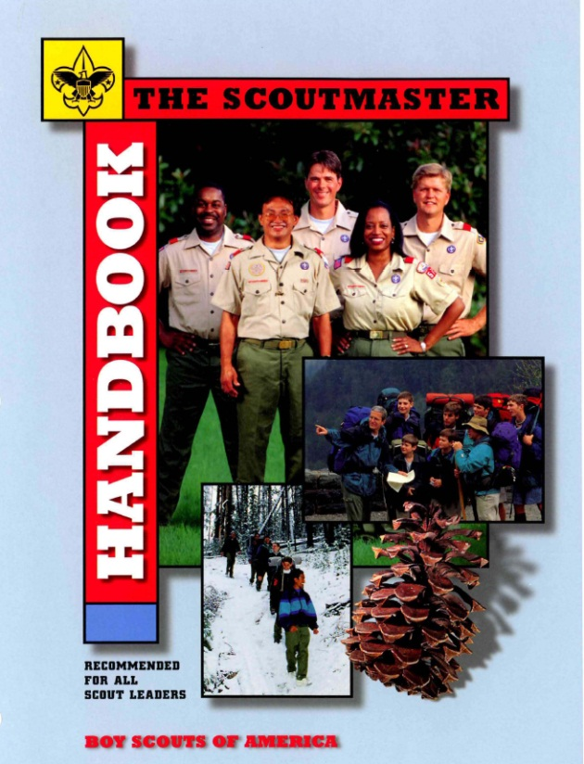
Training Youth Leaders
“Training boy leaders to run their troop is the Scoutmaster’s most important job.”
“Train Scouts to do a job, then let them do it.”
“Never do anything a boy can do.”
—Robert Baden-Powell

Slide 3
BLTUPM
… is an abbreviation for what?

Slide 4
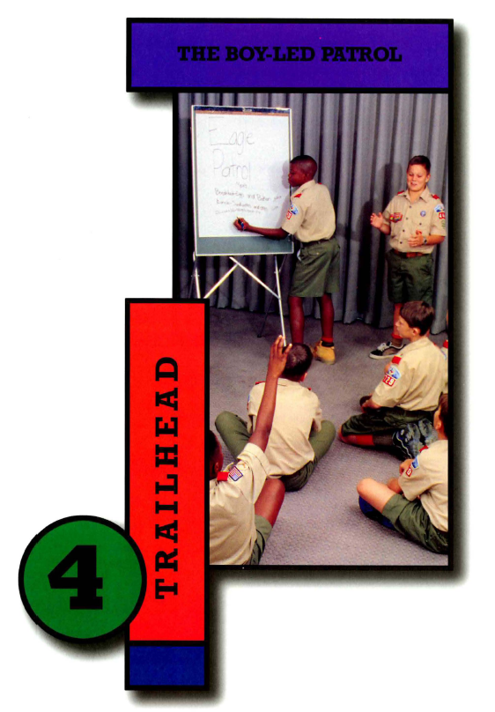
BLTUPM
Scoutmaster Handbook

Slide 5
Frogs
Andy’s Rule No. 76: You can tell some Scoutmasters there are four billion stars in the universe and he believes you, but tell him the Senior Patrol Leader is supposed to be running the troop meeting and he looks at you like you’ve just had frogs leap out of your mouth.
  http://netcommissioner.com/askandy

Slide 7
Outline
Levels of Youth Participation
Measure Empowerment
Propose Play
Describe Resources

Slide 8

Authentic Youth Participation
Shared decision making
with adults
Collaboration with adults
  Adults serve as resources
  and mentors

Slide 9
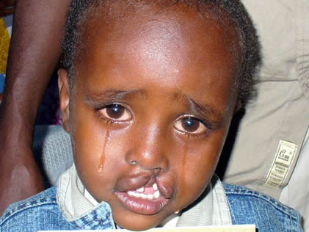
Ladder of Youth Participation
Manipulation
  Adults using young people to promote a cause
  Youth don’t understand the cause
Decoration
  Youth “perform” to promote an adult agenda
  Aim: an emotional response from adults
www.scout.org/en/information_events/library/youth_involvement/
youth_involvement_youth_empowerment

Slide 10
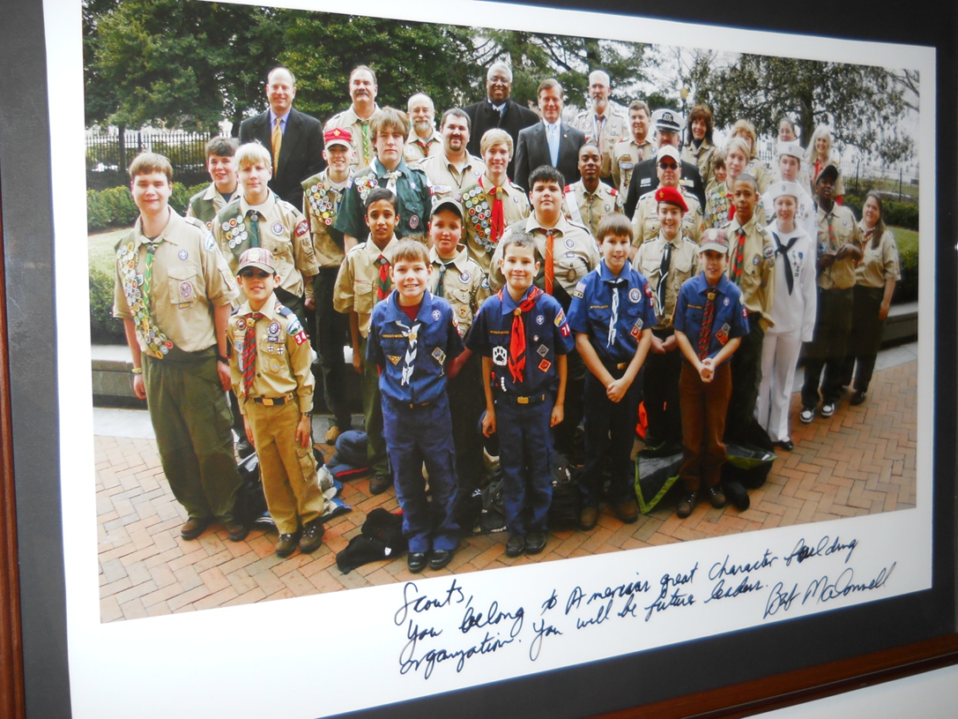
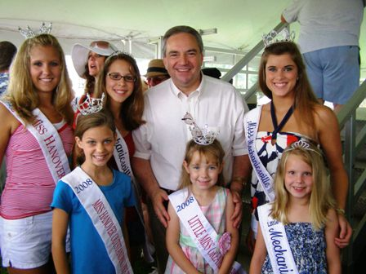
Ladder of Youth Participation
Tokenism
  A youth is scripted to speak to adults
  Supposedly representing youth
Assigned but informed
  Youth participation is decided for them
  Understand: Aims
  Understand: Why they
  were chosen

Slide 11
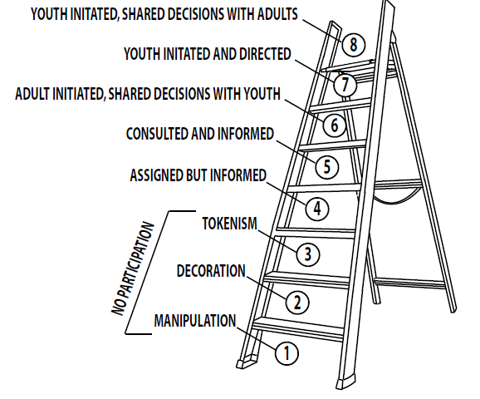



Ladder of Youth Participation
Consulted and informed
  Project designed by adults
  Youth opinions consulted
Adult initiated, Shared decisions
  Youth opinions taken seriously in
  decision making

Slide 12

Ladder of Youth Participation
Assigned but informed
Consulted and informed
Adult initiated, Shared decisions
Youth initiated and directed
  Rare: adult don’t want to give
  up control
  Hard to sustain without
  adult involvement

Slide 13
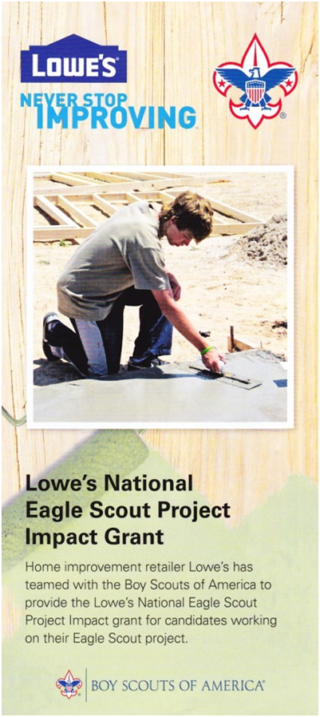
Ladder of Youth Participation
Youth initiated, Shared decisions
  Adults are involved as facilitators for
  the goals of young people
    Resources
    Skill development
    Evaluation help
  Enhances learning for young people,
  builds a sense of community and
  ownership, and adults enjoy the
  enthusiasm of young people

Slide 14

Patrol System Survey Results
Adults may be overly-involved
24% report that planning is largely or wholly accomplished by the adults. Skill instruction happens with direct adult involvement in 73% of the responding Troops.
Of these 8% report that adults do all of the instructing.
36% report that directions to Scouts are largely given by adults, of this 9% report that directions came almost exclusively from adults.

Slide 15
Patrol System Survey Results
Youth leader’s planning is sometimes compromised.
24% report that youth leader’s plans are either nonexistent or frequently revised or vetoed by adults.
60% report that adults other than the Scoutmaster attend patrol leader’s council meetings and 53% speak up and advise Scouts during these meetings on a regular basis.
26% of troops report that adults have the primary responsibility for planning meetings and events.

Slide 16
Patrol System Survey Results
Patrols don’t appear to have a large measure of independence or continuity
45% of patrols are often combined for an activity or event.
49% of patrols have 10 minutes or less scheduled at troop meetings, 17% have no time scheduled.
41% of troops have inter-patrol competitions less than once a month.
87% of troops do not have their patrols set up independent campsites; of these 29% make no differentiation of patrols at all when camping.
60% of patrols have no independent meetings or activities.

Slide 17
Participation ↔ Empowerment
Consider who
  Has most of the information?
  Initiates, sets the agenda?
  Decides, plans and organizes?
  Expertise is implemented?
  Sets up the structure and rules?
  Evaluates?
  Has the power?
Notes:
1. Initiation of the method: Whose
idea was it?
2. The agenda: Who decides what is
discussed?
3. Decision-making: Who makes
decisions about how to
proceed?
4. Information: Who holds the
information necessary for
decision-making?
5. Implementation: Who takes
action on decisions?
6. Structure of participation: How
formal or informal is it; does it
replicate the adult structure?
As with the ladder model, there is no single correct way of involving young people

Slide 18
Rate Participation
Activity:
Adults … | –5 … 0 … +5 | Youth …
...have most of the info. |  | ...have most of the info.
...initiated |  | …set the agenda
...plan and organize |  | ...plan and organize
...make the decisions |  | ...make the decisions
...expertise is used |  | ...expertise is used
...set the rules |  | …decided the structure
…evaluated |  | …feedback is actively sought
…have the power | <= shared / in between => | …are empowered

Slide 19

Rate Participation
Okpik outing to Northern Tier
Ely Minnesota during Winter, 2006
Adults … | –5 … 0 … +5 | Youth …
...have most of the info. | +5 | ...have most of the info.
...initiated | +5 | …set the agenda
...plan and organize | +5 | ...plan and organize
...make the decisions | +5 | ...make the decisions
...expertise is used | +4 | ...expertise is used
...set the rules | 0 | …decided the structure
…evaluated | +4 | …feedback is actively sought
…have the power | !!!!! | …are empowered

Slide 20

Rate Participation
Activity: 25th Annual
Scouting for Food
Adults … | –5 … 0 … +5 | Youth …
...have most of the info. |  | ...have most of the info.
...initiated |  | …set the agenda
...plan and organize |  | ...plan and organize
...make the decisions |  | ...make the decisions
...expertise is used |  | ...expertise is used
...set the rules |  | …decided the structure
…evaluated |  | …feedback is actively sought
…have the power | <= shared / in between => | …are empowered

Slide 21
Participation ↔ Empowerment
Consider how youth can
  Have most of the information
  Initiate and set the agenda
  Decide, plan, and organize
  Use their expertise
  Use their structure and rules
  Reflect on “we did it ourselves”
  Have power
Notes:
1. Initiation of the method: Whose
idea was it?
2. The agenda: Who decides what is
discussed?
3. Decision-making: Who makes
decisions about how to
proceed?
4. Information: Who holds the
information necessary for
decision-making?
5. Implementation: Who takes
action on decisions?
6. Structure of participation: How
formal or informal is it; does it
replicate the adult structure?
As with the ladder model, there is no single correct way of involving young people

Slide 22
How to foster participation
“Scouting is a game for boys
under the leadership of boys
under the direction of a man” B-P
That is, adult leaders should
provide opportunities for play

Slide 23
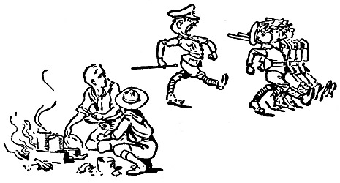
Play
Impression vs. Expression
“Scouting is not soldiering” B-P

Slide 24
BLTUPlayM
Baden-Powell wrote that play is the first great educator. He also described Scouting as a game full of gusto.
Play is often defined as a futile activity of no real importance. It is seen as the opposite of work, which is a serious activity.

Slide 25
Team Play
Listening; Communicating
Agreeing on goals; understanding authority
Dealing with differing abilities
Challenge and Choice
Collaborate or Compete?
Spirit and Support
Decision making
  including dealing with consequences
OMHIWDMB or Winning, period?
Notes:
Teams: what to do with the less able? Or, if you are the less able-sabotage & sandbag
Communication; agreeing on goals
Listening

Slide 26
Offering Play
The answer is simple: the adult leader should offer as much “play” as possible, taking into account the capabilities of the young people.
Offering as much play as possible means establishing a framework allowing room for initiative while ensuring guidance and security.

Slide 27
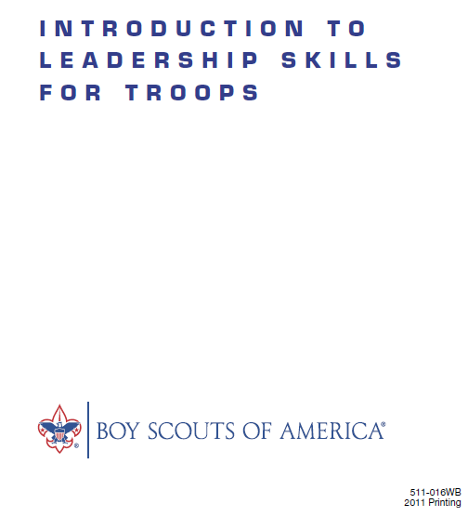
Resources
The BSA syllabus for
training youth
leaders is ILST
www.scouting.org
>Training
>Youth

Slide 28
ILST: How to Use Games
Be Prepared!
  Know how the game is played,
  what the objectives are, and
  how its parts lead to learning the objective.
Present the Game
  Make the rules clear
  Stand back
Lead the Reflection

Slide 29
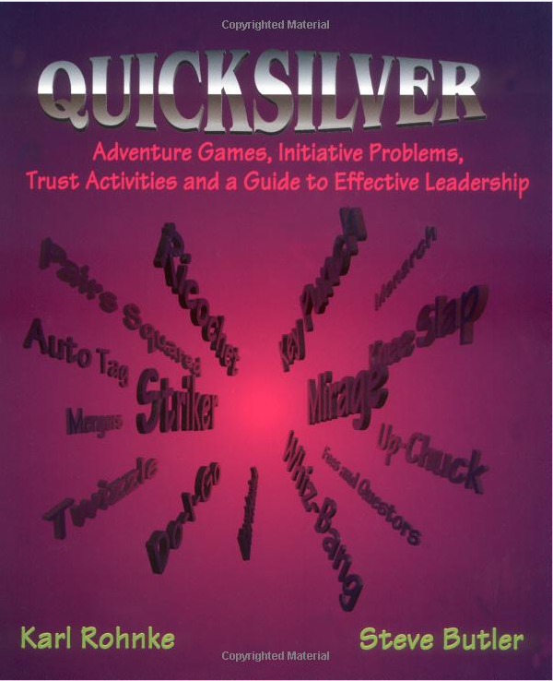
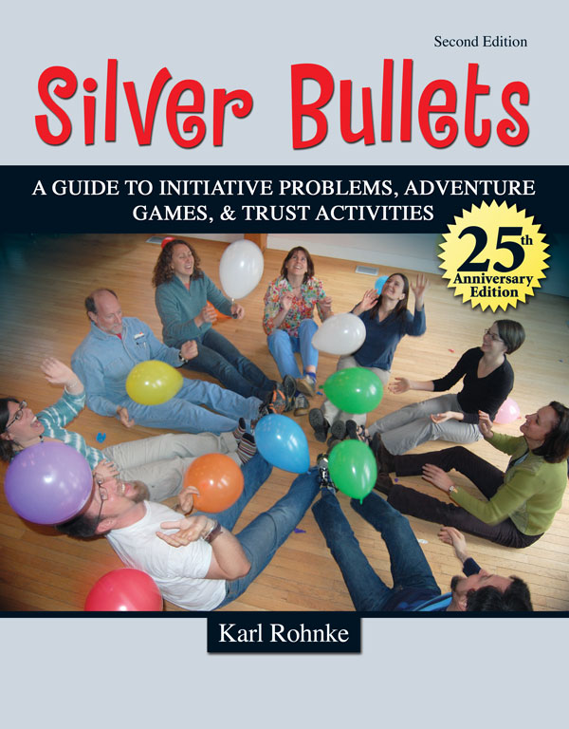
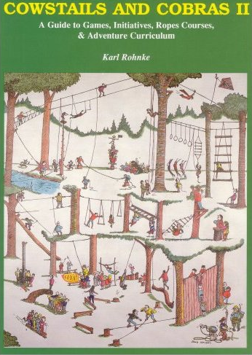
Project Adventure
www.pa.org

Slide 30

Methods of Scouting
The ideals
The patrol method
The outdoors
Advancement
Adult association
Personal growth
Leadership development
The uniform

